Slide 1
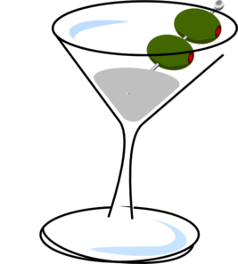
To cocktail or not to
Joshua Banks Mailman

Slide 2
Predicting whether a food is used in a cocktail recipe
Shed light on
• drinkers’ tastes and preferences
• drink-mixing creativity
• cocktails-to-be

Slide 3
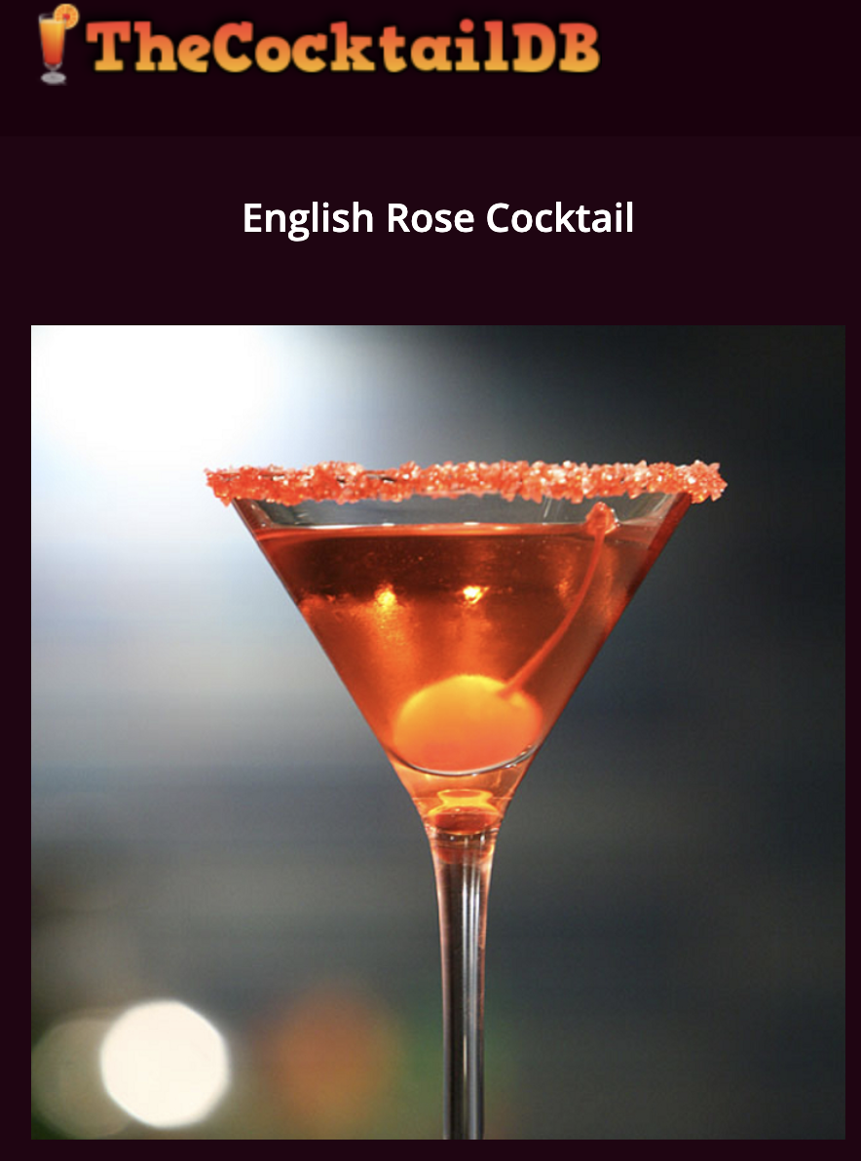


Sources
for food data
Foodb.ca
for cocktail recipes
CocktailDB.com (json)
PubClub.com
m
Th

Slide 4
550+
900+
5,000,000+
150+
cocktail ingredients
cocktail recipes
foods
food compound concentration measurements

Slide 5
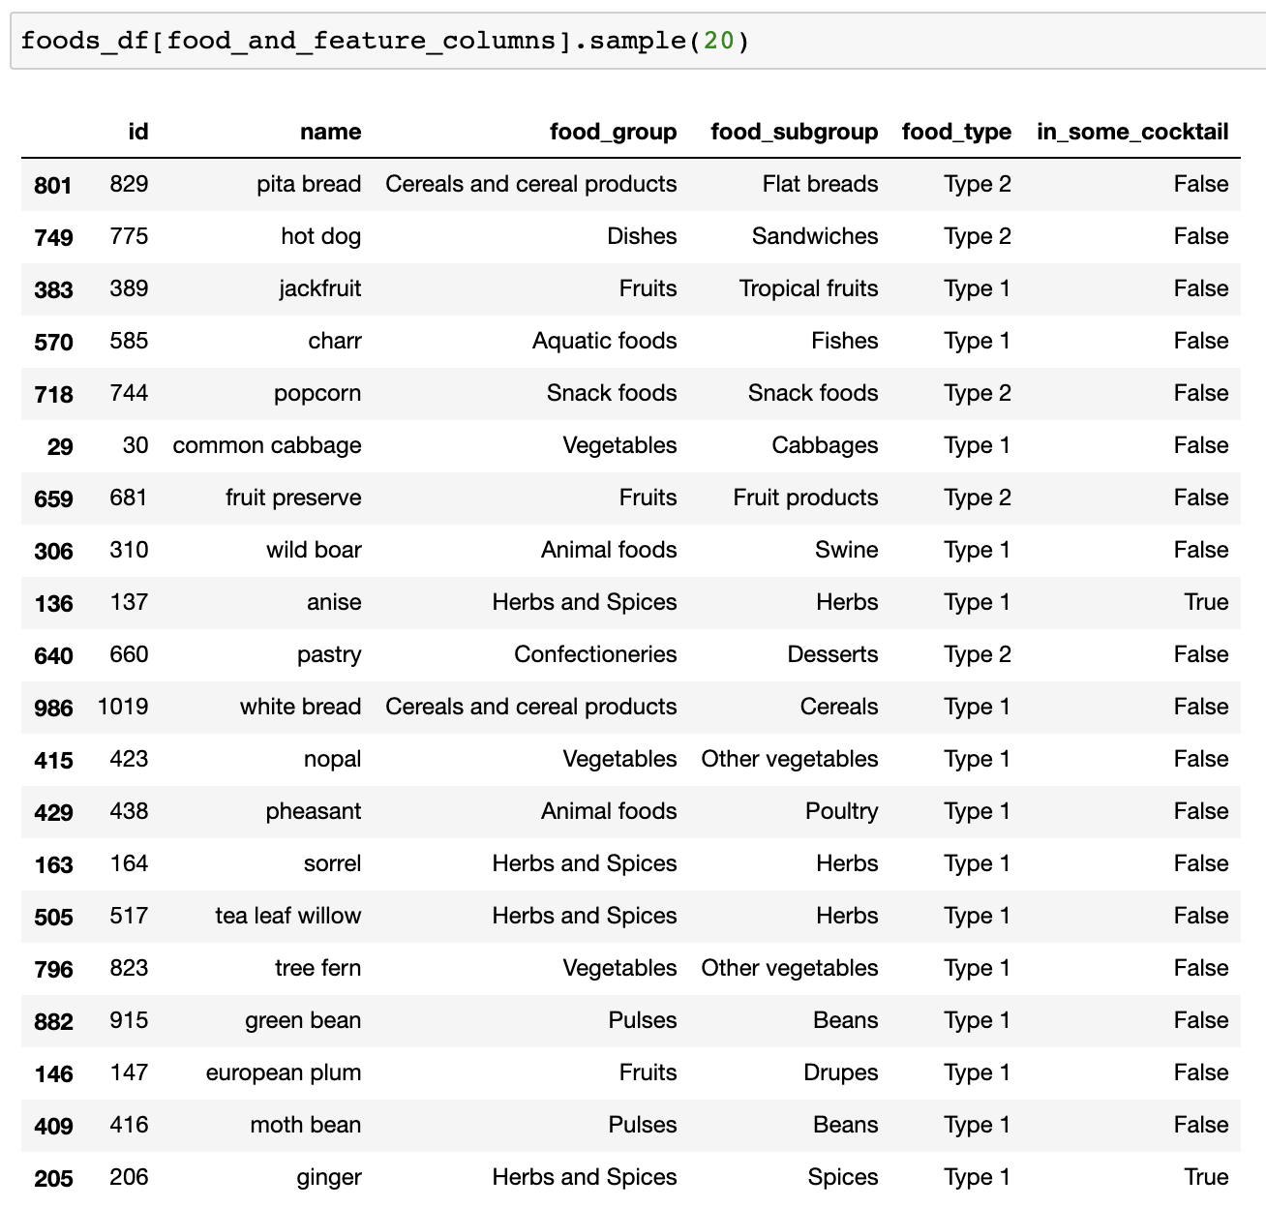
food categories
Processed food
Features
of foods
Unprocessed food
100+
categorical features
(food groups and subgroups)

Slide 6
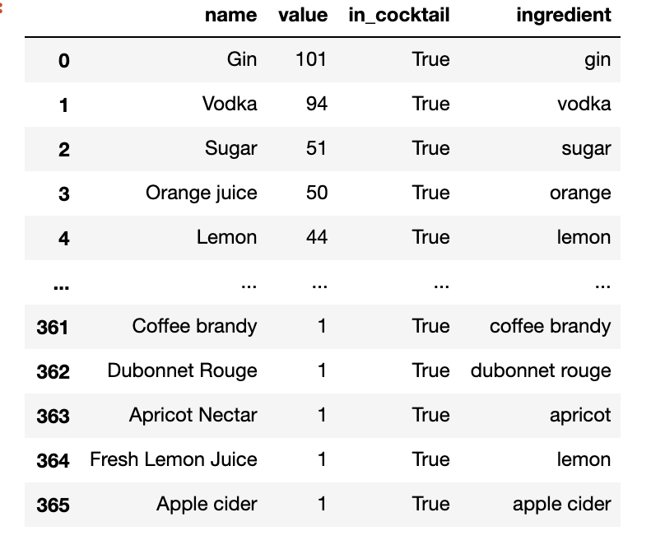
Ingredients in cocktails
GIGO ?
Literal interpretation of words can be thorny

Slide 7

Linking datasets to provide target labels
A significant pre-processing step
The Python NLTK Lemmetizer helped a little

Slide 8
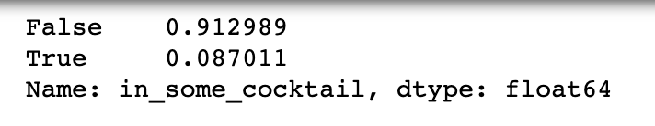
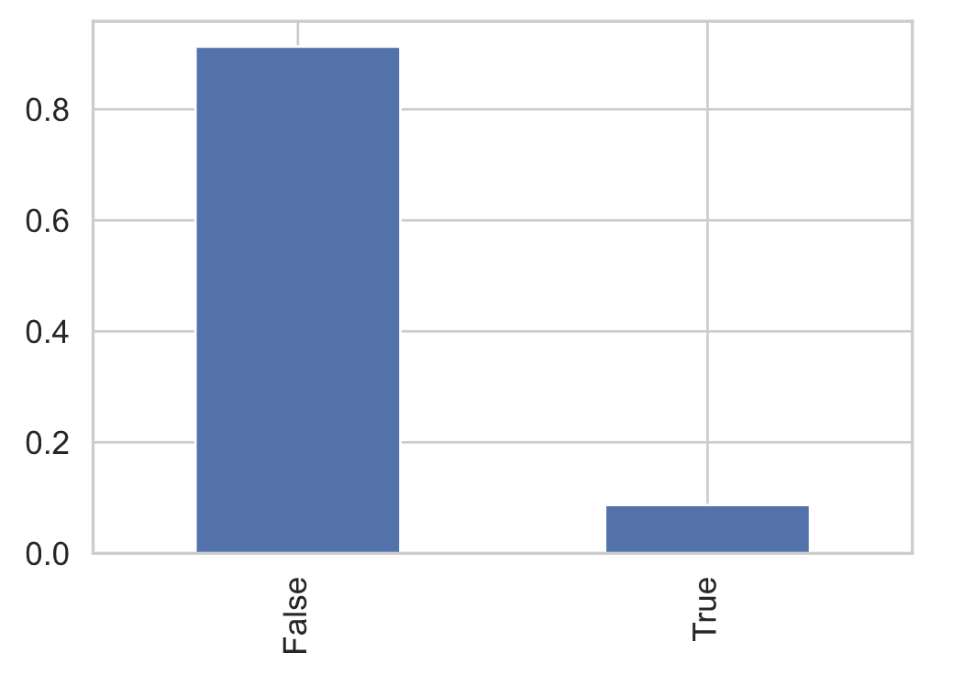
Class imbalance
So accuracy will not be a good metric
Not in a cocktail
0.856242
In a cocktail as;kj;kj;k
0.143758
Proportions:

Slide 9
Categorical features
Logistic Regression
based on just

Slide 10
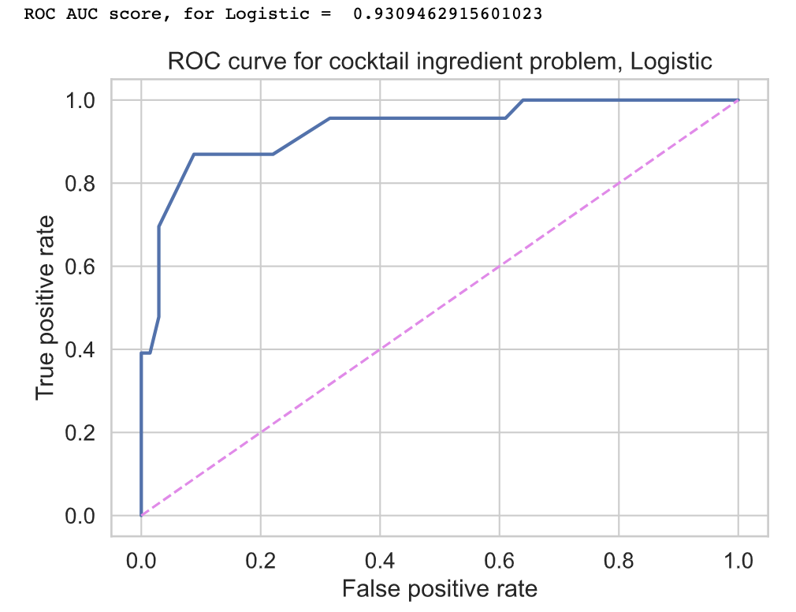
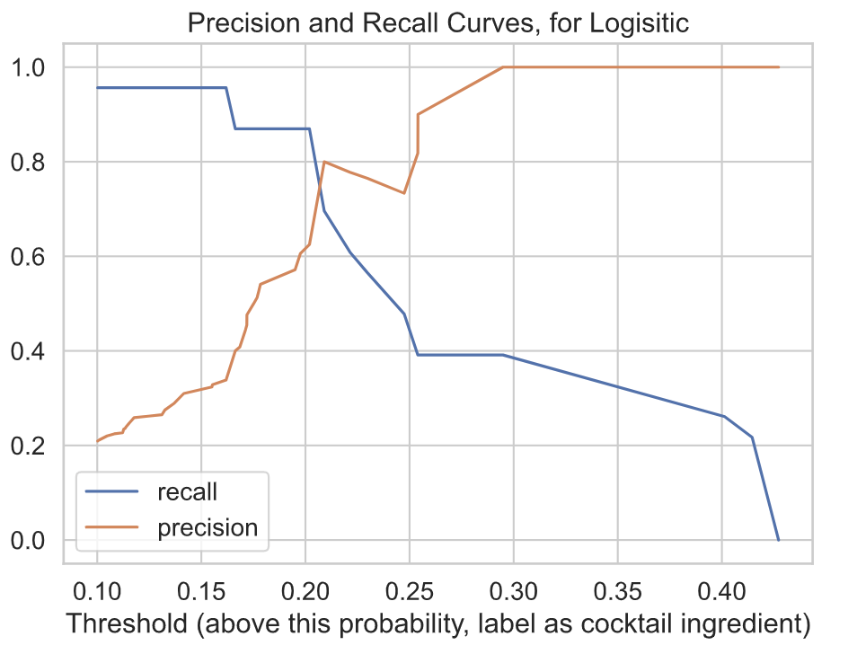
Categorical features
Logistic Regression
based on just
one trial
Log loss cross-entropy
train val difference
to gauge overfitting
0.3340 0.3047 -0.0293
Precision: 0.6061 Recall: 0.8696 with threshold: 0.2

Slide 11
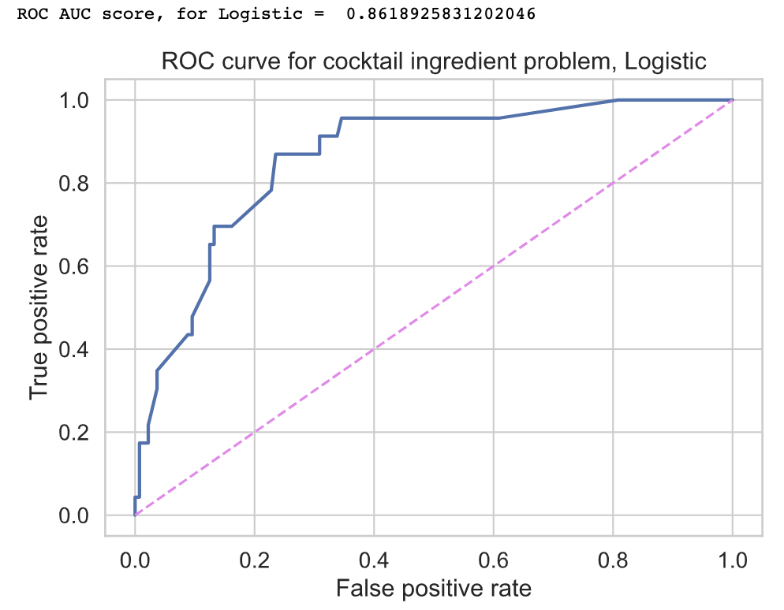
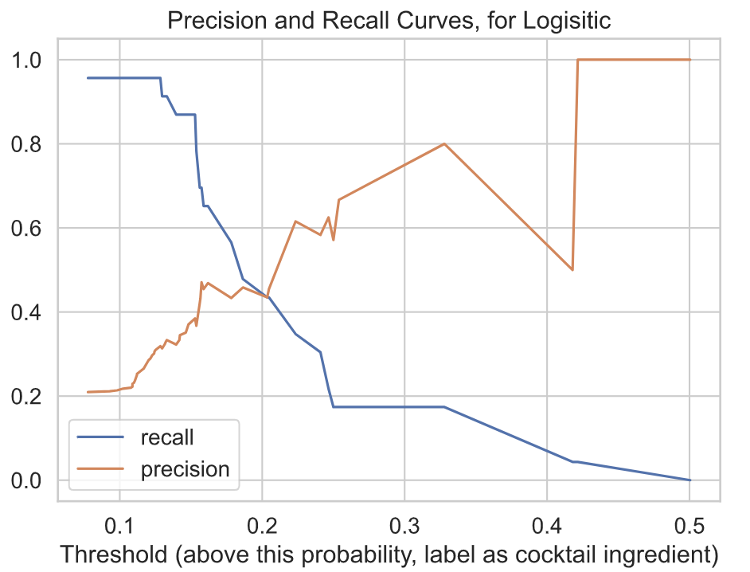
Categorical features
Logistic Regression
based on just
another trial
Log loss cross-entropy
train val difference
to gauge overfitting
0.3340 0.3047 -0.0293
0.3210 0.3382 0.0172
Precision: 0.6061 Recall: 0.8696 with threshold: 0.2

Slide 12
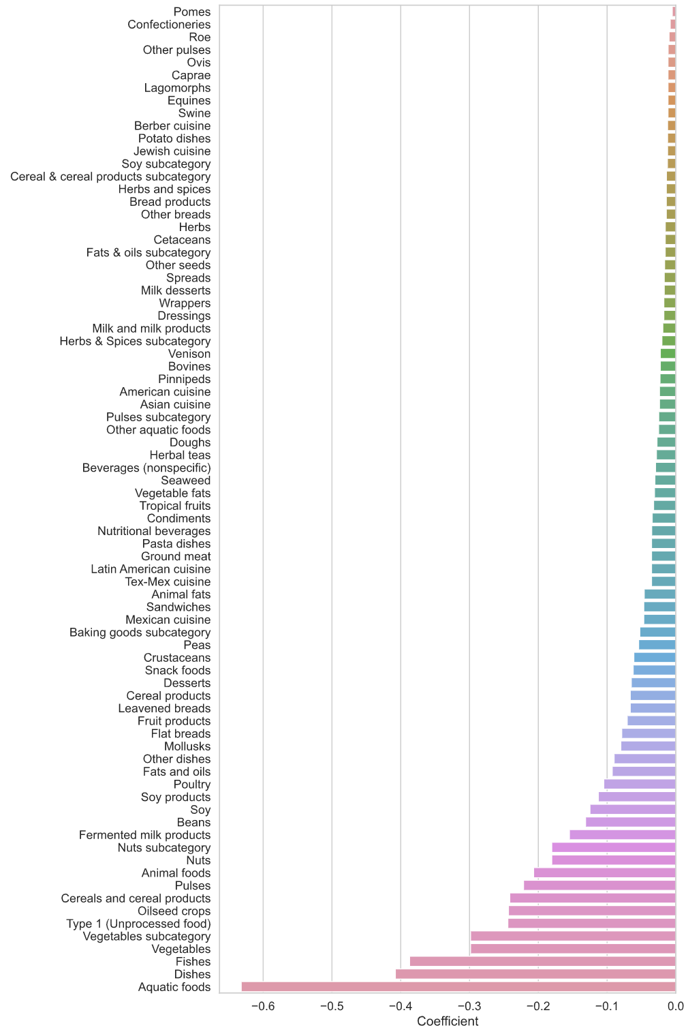
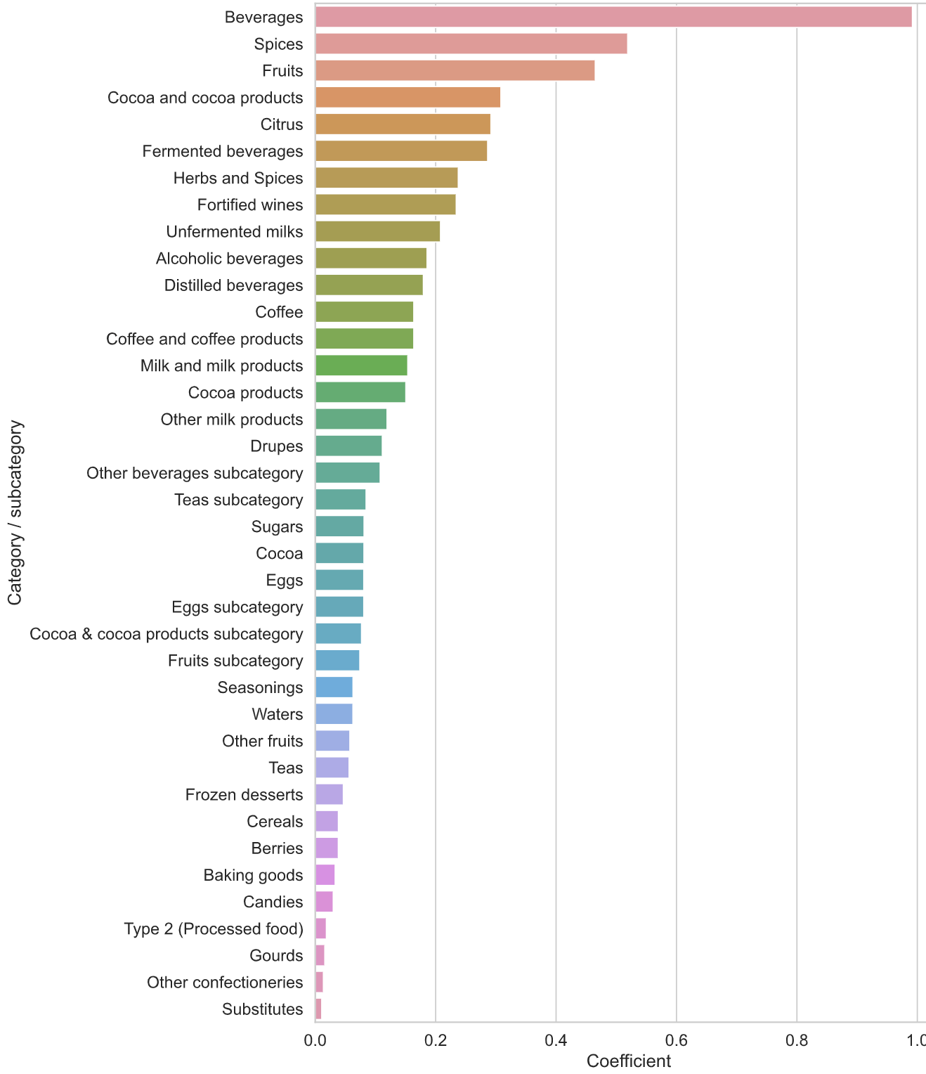
Logistic Regression (on continuous features) coefficients
contributors
(positive coefficients)

Slide 13
Logistic Regression (on continuous features) coefficients
detractors
(negative coefficients)

Slide 14
Multiple scenarios
Categorical features

Slide 15
Insight into food feature importance
Independent of conventional food groupings

Slide 16
Continuous features
Features
of foods

Slide 17
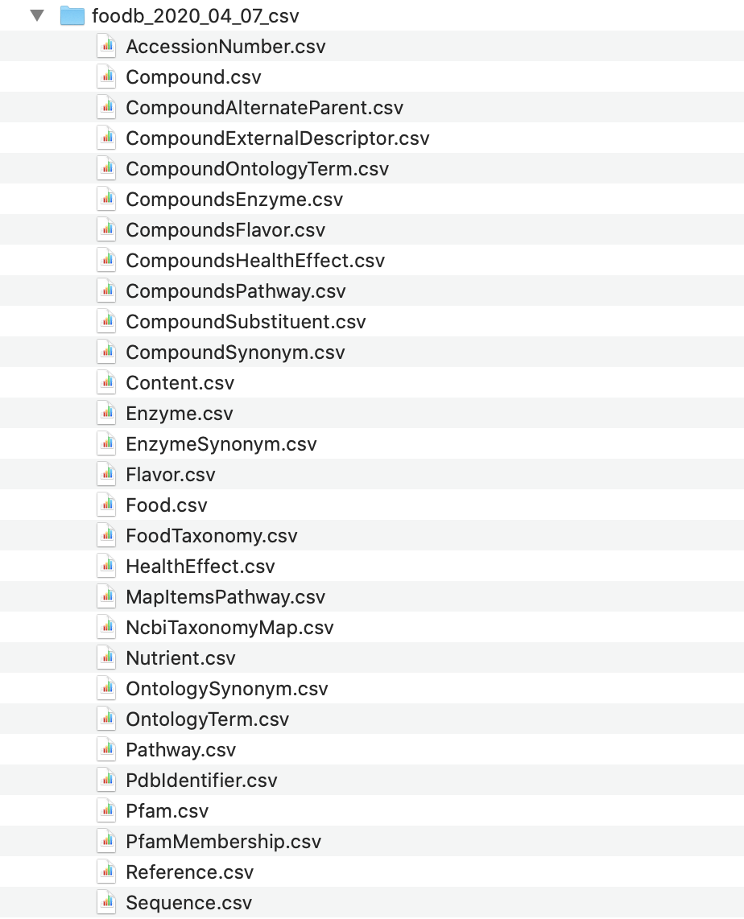
Source for food data
Foodb.ca
900+
foods
5,000,000+
food compound concentration measurements

Slide 18
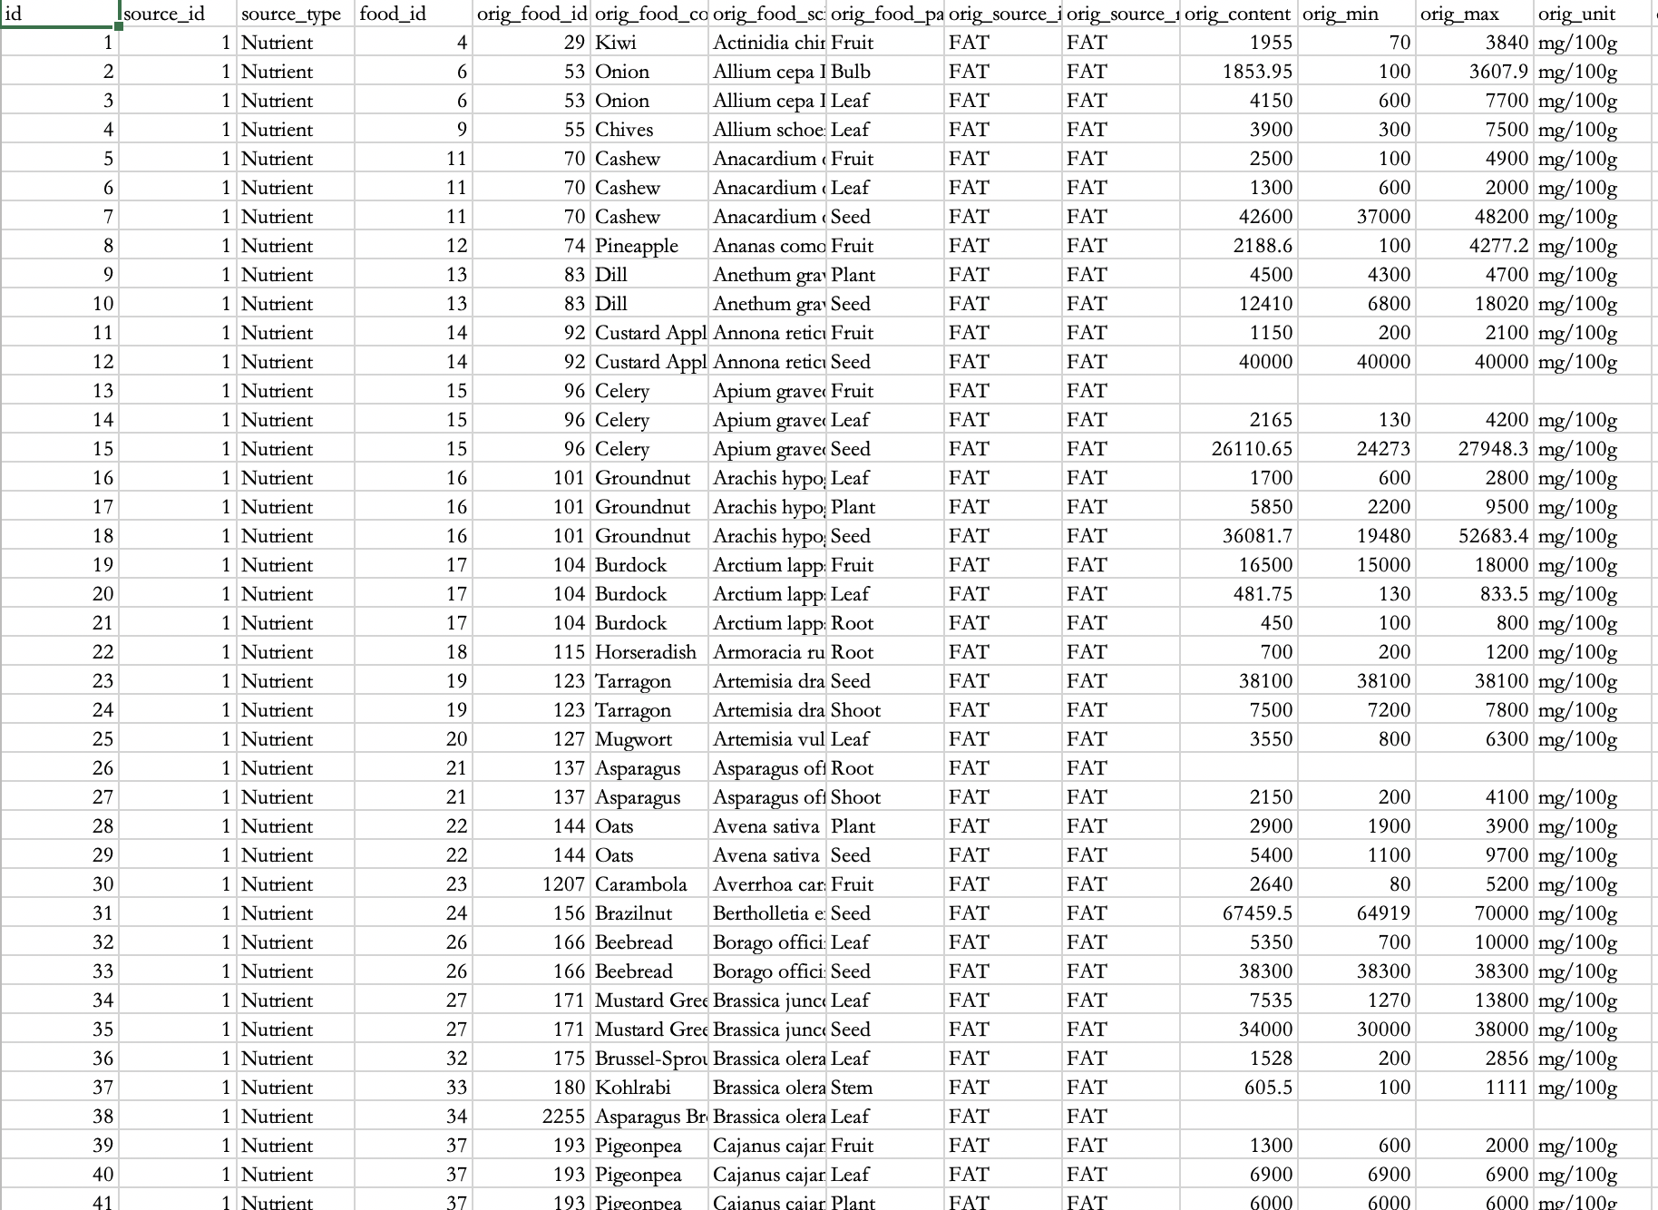

Slide 19
Concentration: mg/100g

Slide 20
900+
foods

Slide 21
15,000 continuous features were engineered by aggregating the 5 million compound concentrations for each part of all 900 foods.
21

Slide 22
Multiple scenarios
Categorical features
Continuous features only
Categorical & continuous features

Slide 23
using continuous features only
15000+ features, each a concentration of a compound in a food
to gauge overfitting

Slide 24
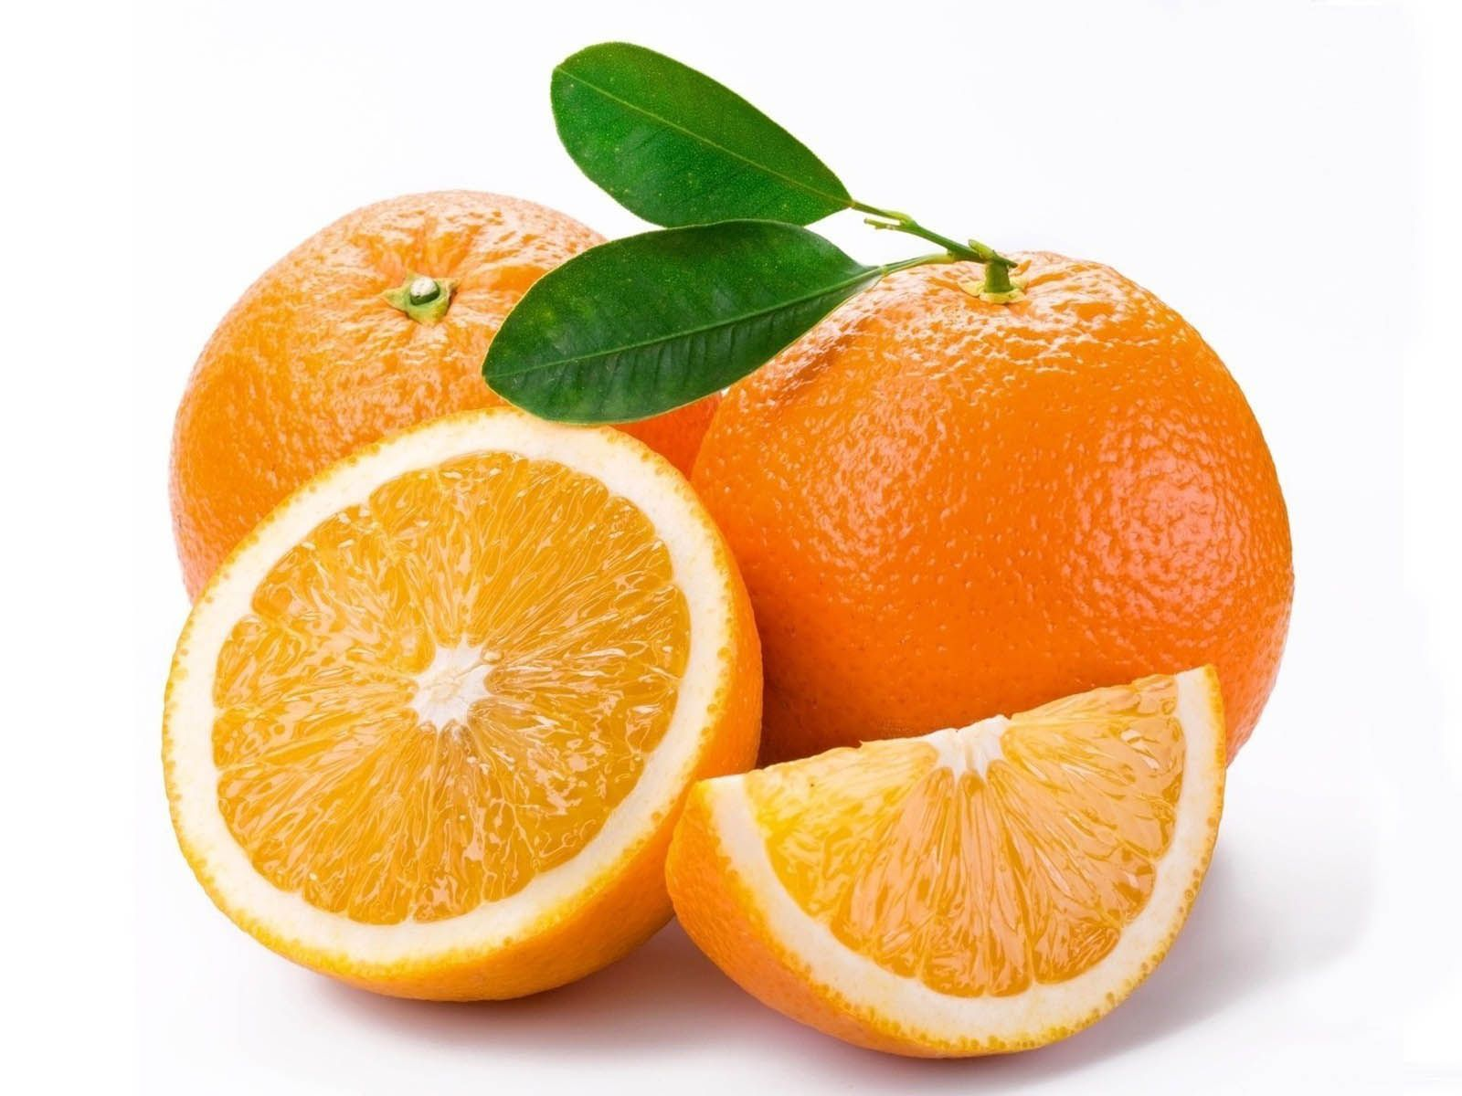
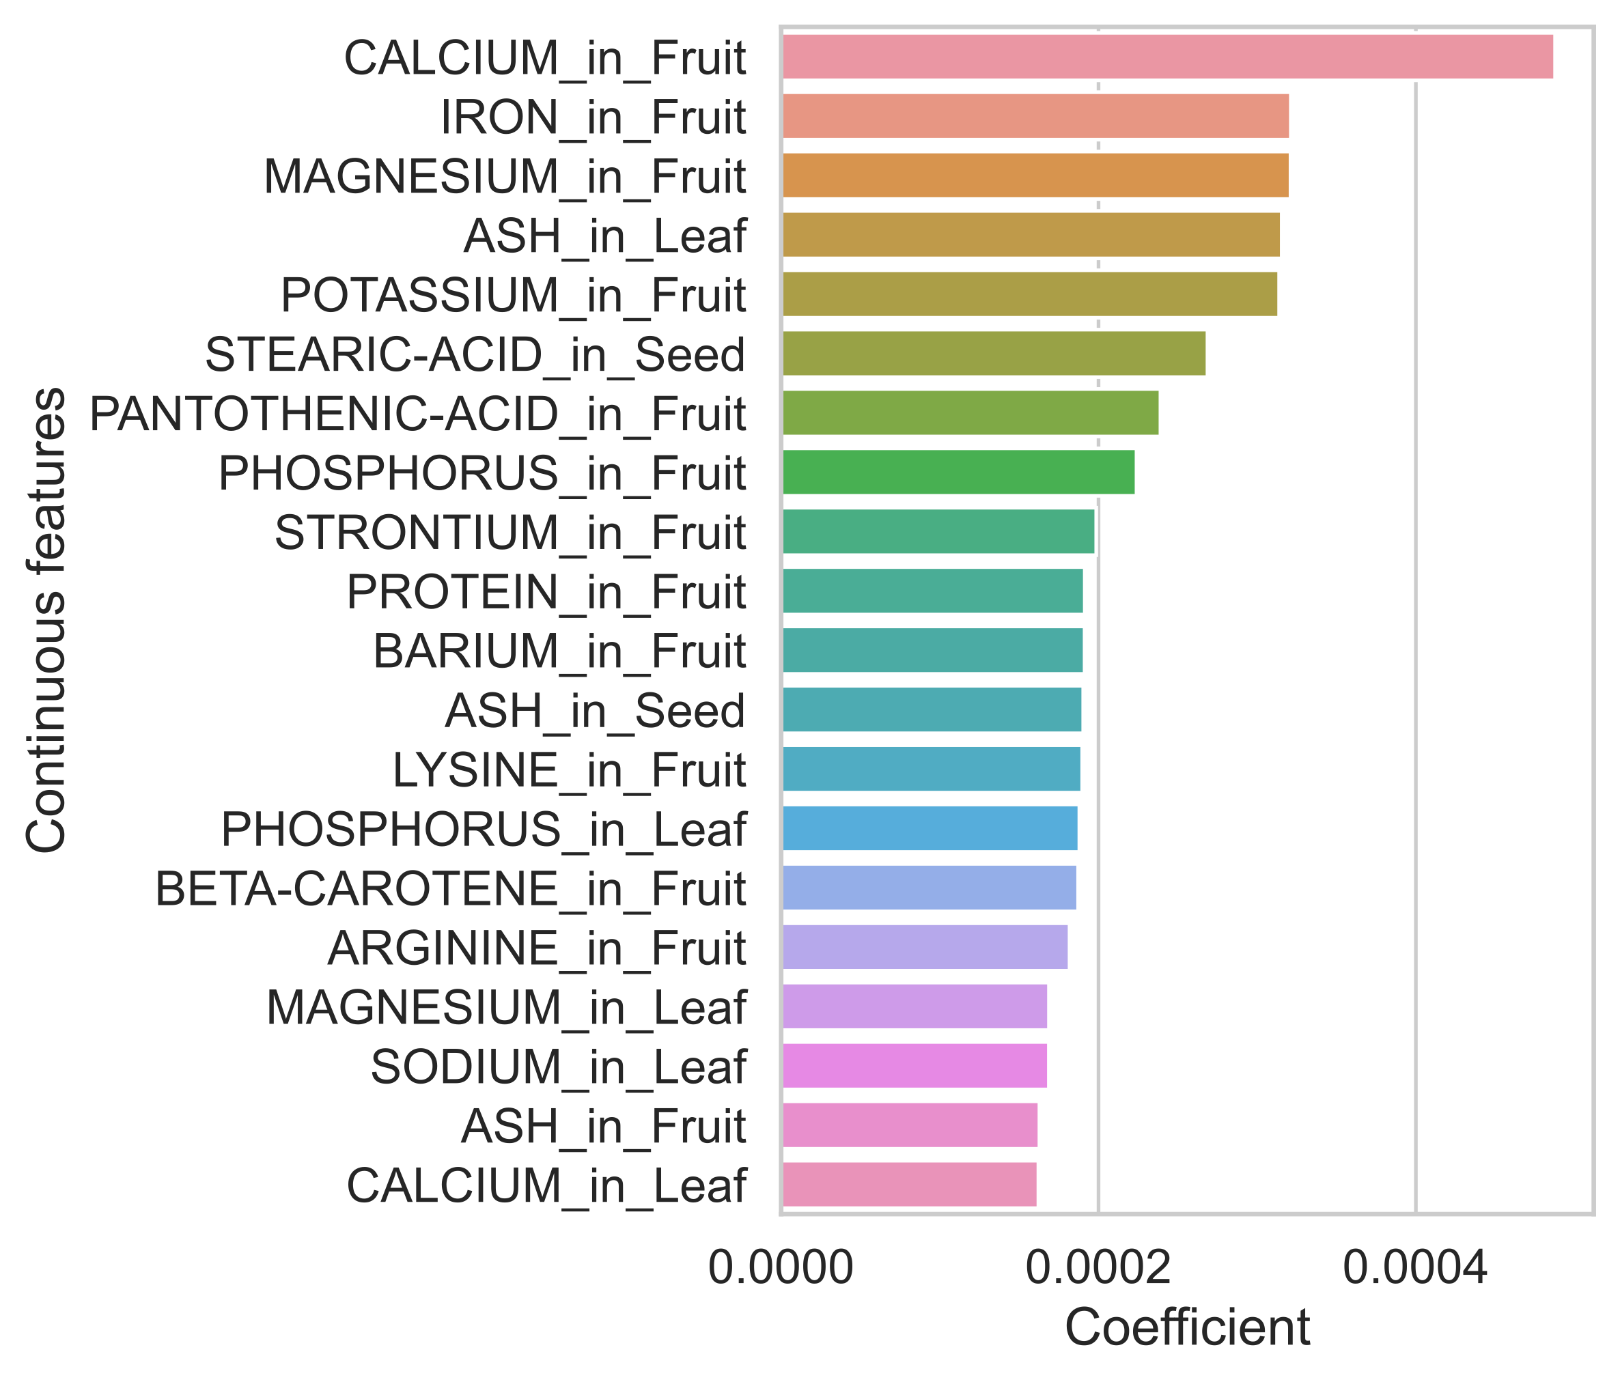
Logistic Regression (on continuous features) coefficients
contributors
(positive coefficients)

Slide 25
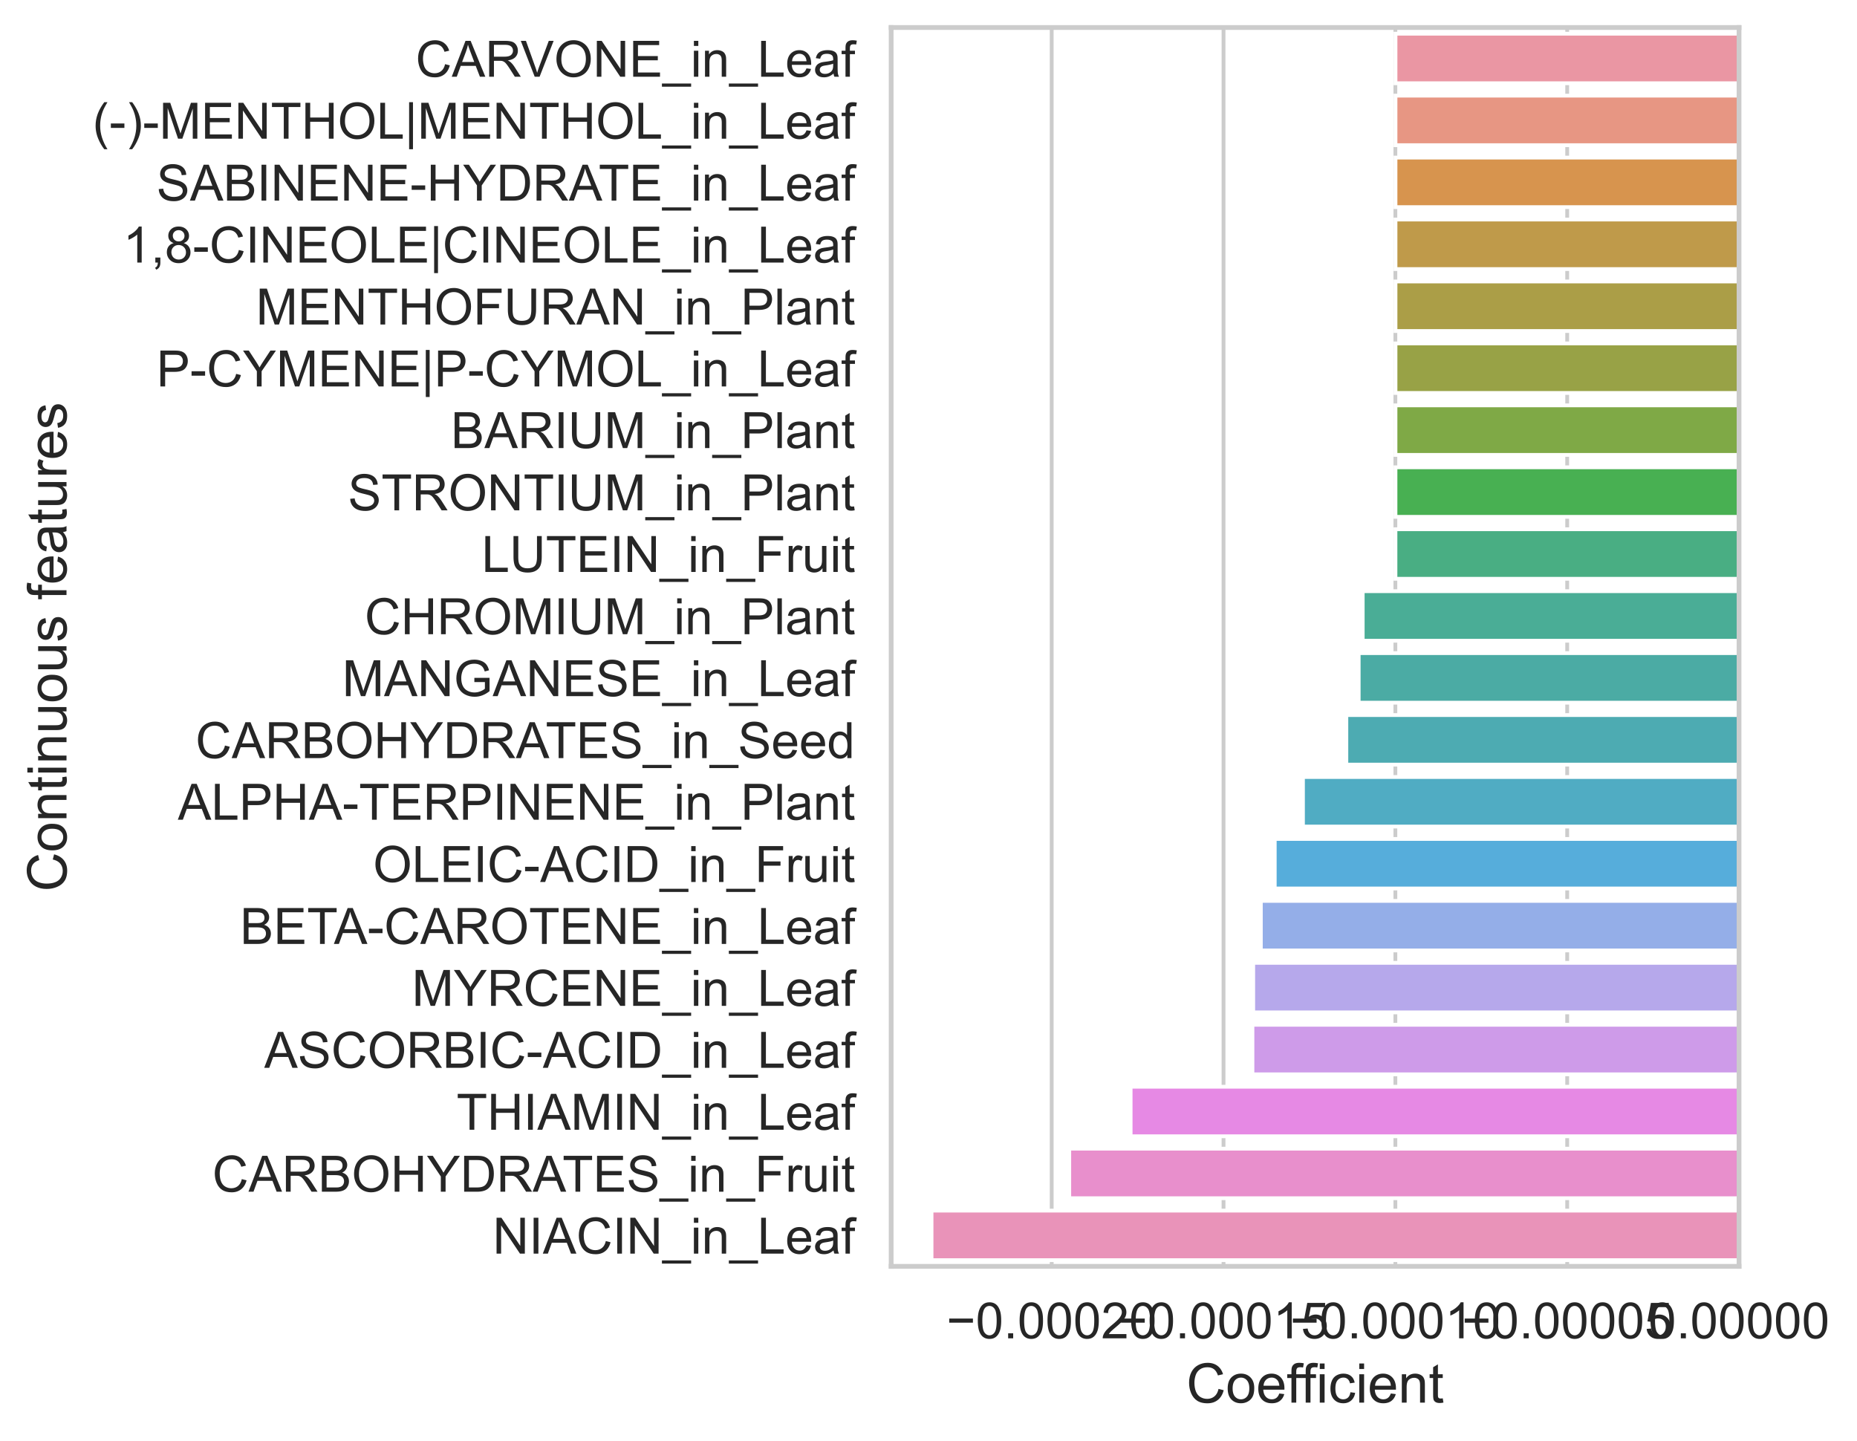
Logistic Regression (on continuous features) coefficients
detractors
(negative coefficients)

Slide 26
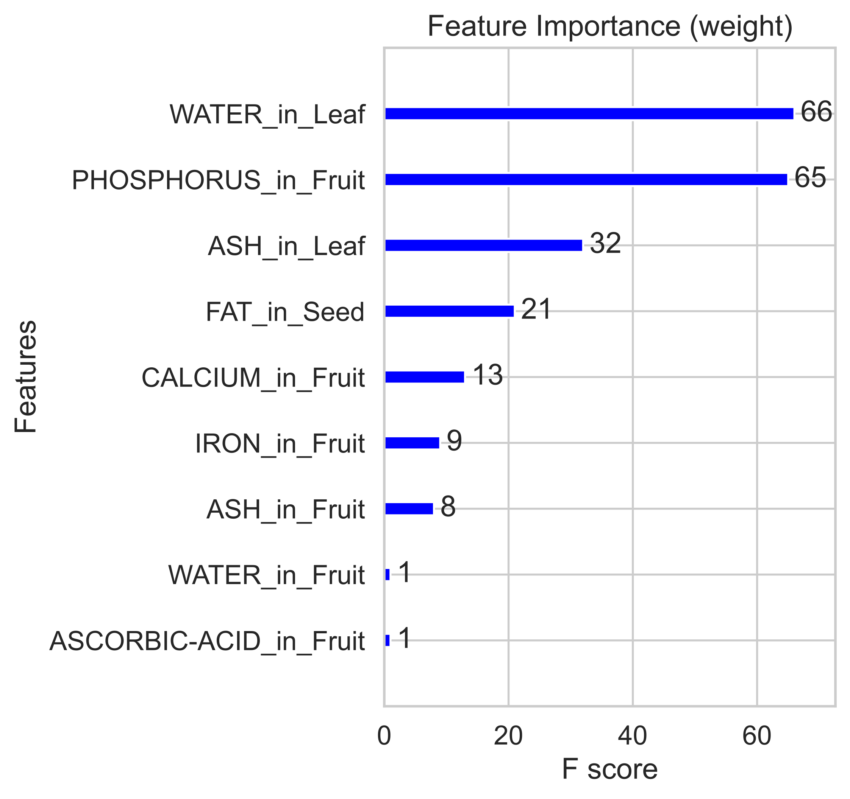
XGBoost ‘Important Features’
‘weight’

Slide 27
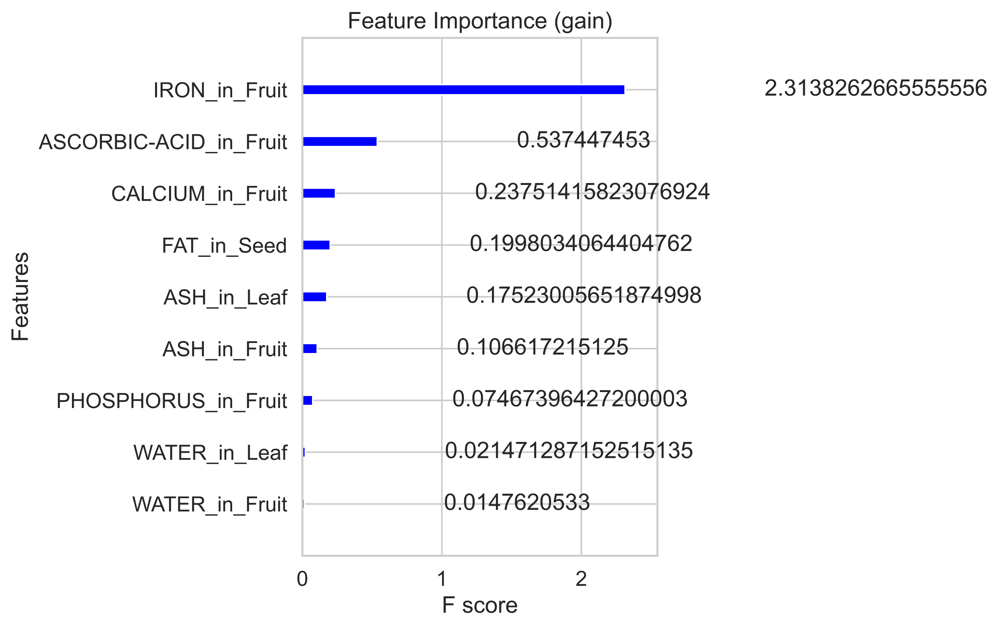
XGBoost ‘Important Features’
‘gain’

Slide 28
15,000 is a lot of features for only 900 rows. Danger of overfitting

Slide 29
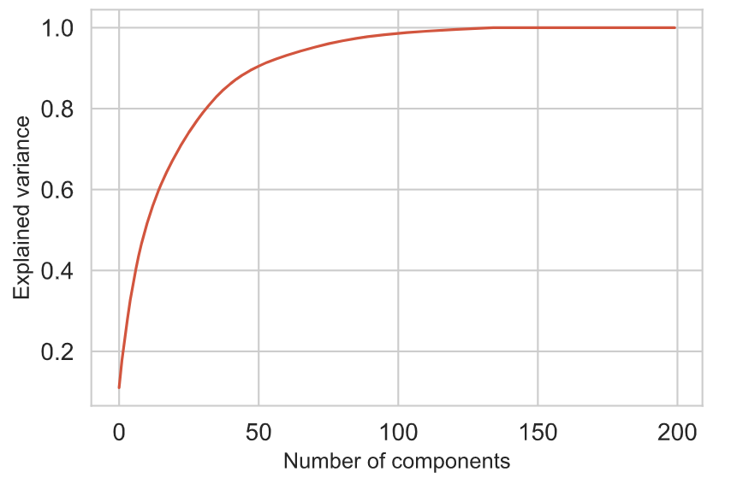
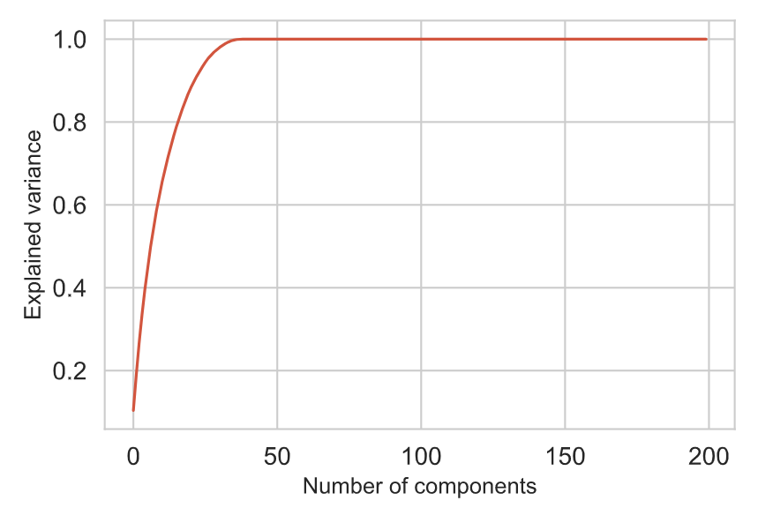
Principal Component Analysis
15,000 is a lot of features for only 900 rows. Danger of overfitting
To reduce the given features down to a set of synthesized features that capture as much variance as possible
PCA on all features
PCA on continuous features

Slide 30
Multiple scenarios
Categorical features
Continuous features only
PCA on all features
Categorical & continuous features
Continuous features w/ PCA
Categorical
as-is with continuous features w/ PCA

Slide 31
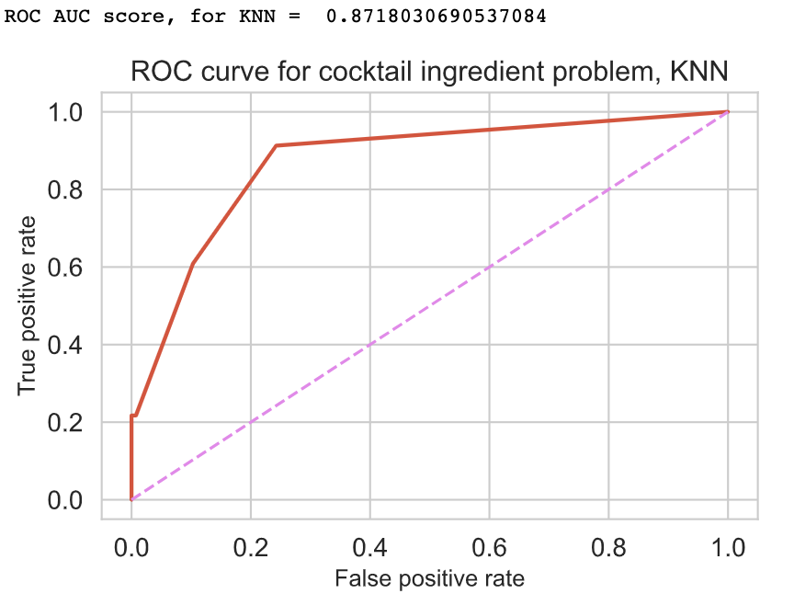
Categorical features and 40 principal components based on the continuous variables
With oversampling
KNN

Slide 32
Multiple scenarios
Because of class imbalance,…
Categorical features
Continuous features only
PCA on all features
Categorical & continuous features
Continuous features w/ PCA
Categorical
as-is with continuous features w/ PCA
Categorical
as-is with continuous features w/ PCA, oversampled

Slide 33
Categorical features and 40 principal components based on the continuous variables
With oversampling
KNN

Slide 34
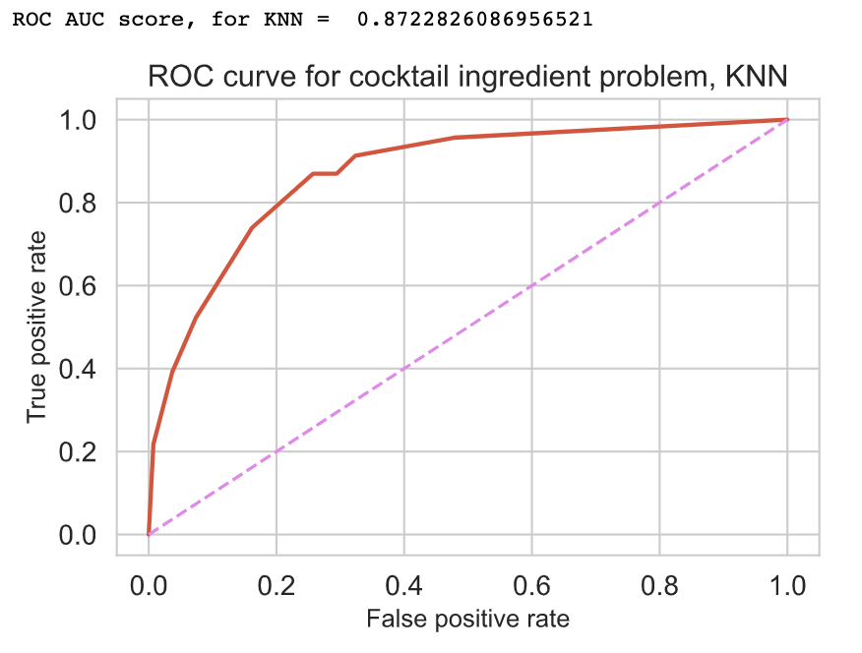
Categorical features and 40 principal components based on the continuous variables
With oversampling
KNN

Slide 35
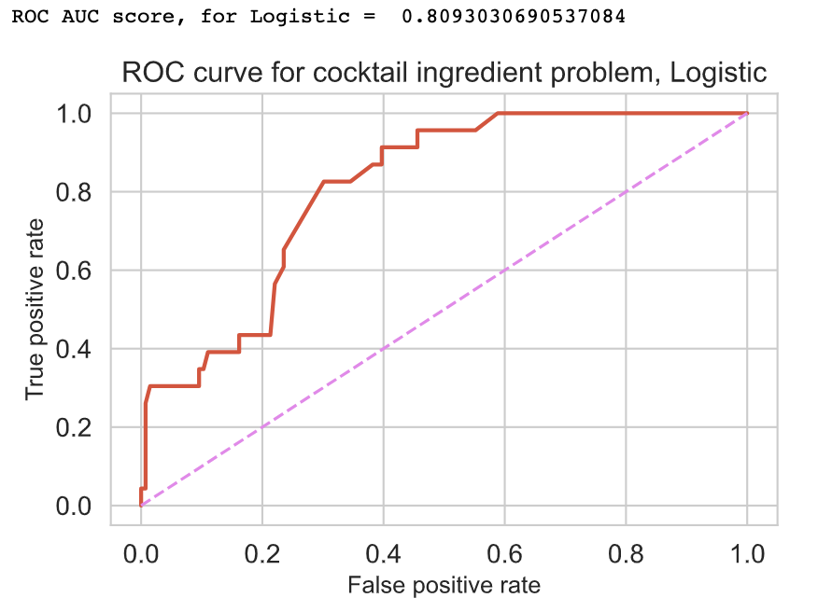
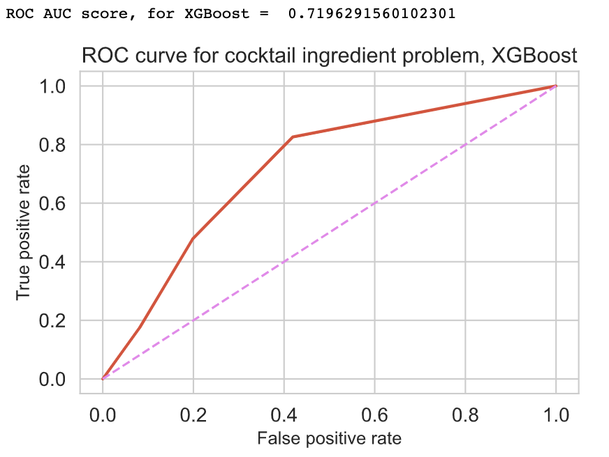
Categorical features and 40 principal components based on the continuous variables
With oversampling
Logistic
KNN
XGBoost

Slide 36
Categorical features and 40 principal components based on the continuous variables
With oversampling
to gauge overfitting
Although logistic doesn’t overfit , the log loss cross entropy is suboptimal.

Slide 37
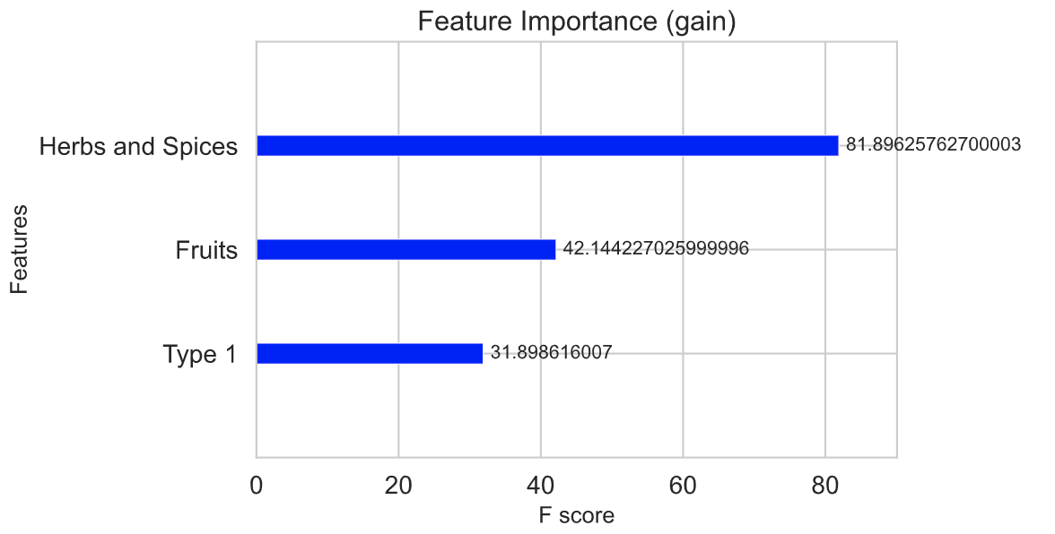
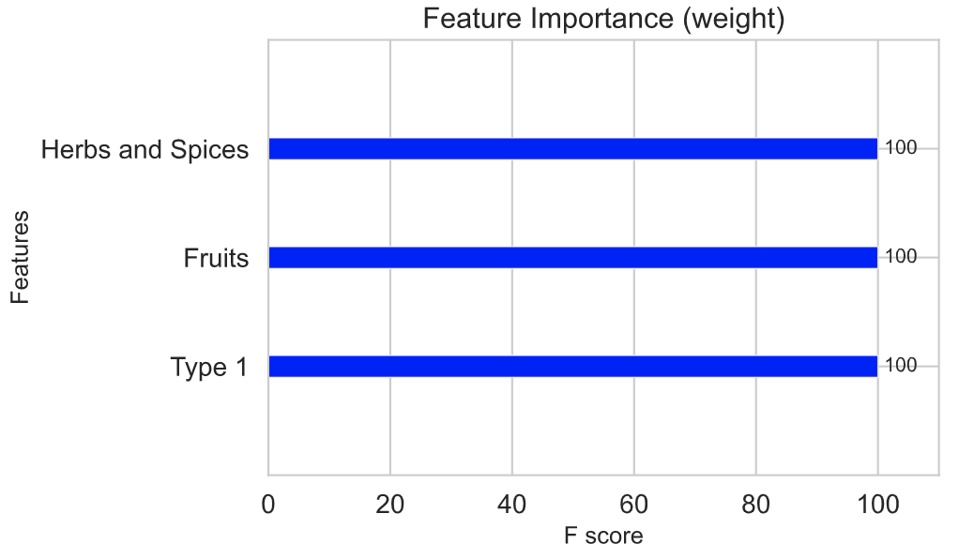
XGBoost revealing important categorical features
With oversampling
(Unprocessed food)
(Unprocessed food)
(Unprocessed food)
(Unprocessed food)

Slide 38
More speculative feature engineering
relative concentration
of each compound

Slide 39
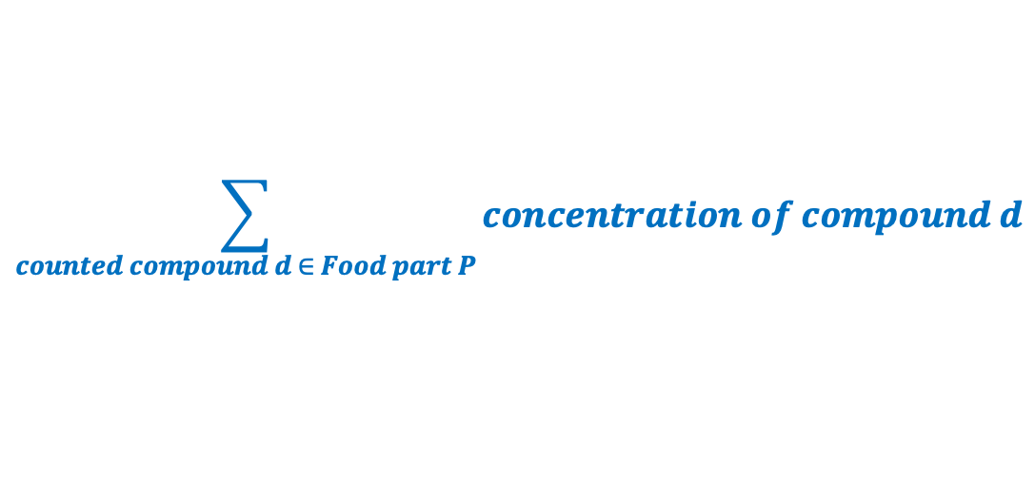
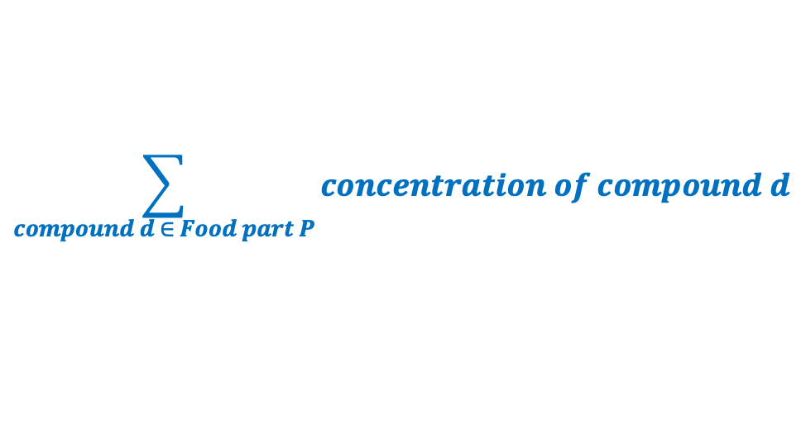
Food DB provides
$$\sum_{compound d ∈ Food part P}{concentration of compound d}$$
‘gain’
mg of c
=
Concentration of compound c in food part P
100g of material in food part P
Another possible engineered feature:
Concentration of compound c in food part P
=
Relative concentration of compound c in food part P
$$\sum_{counted compound d ∈ Food part P}{concentration of compound d}$$
It EXAGGERATES, amplifies, any compound that dominates a food part in terms of compounds that are counted.
It privileges compounds in food parts whose weight is not fully counted in terms of compounds.

Slide 40
Thus 8,000 new continuous features
relative concentration
of each compound in each part of each food

Slide 41
Multiple scenarios
Categorical features
Continuous features only
PCA on all features
Categorical & continuous features
Continuous features w/ PCA
Categorical
as-is with continuous features w/ PCA
Categorical
as-is with continuous features w/ PCA, oversampled
All the above with 8,000 engineered continuous features

Slide 42
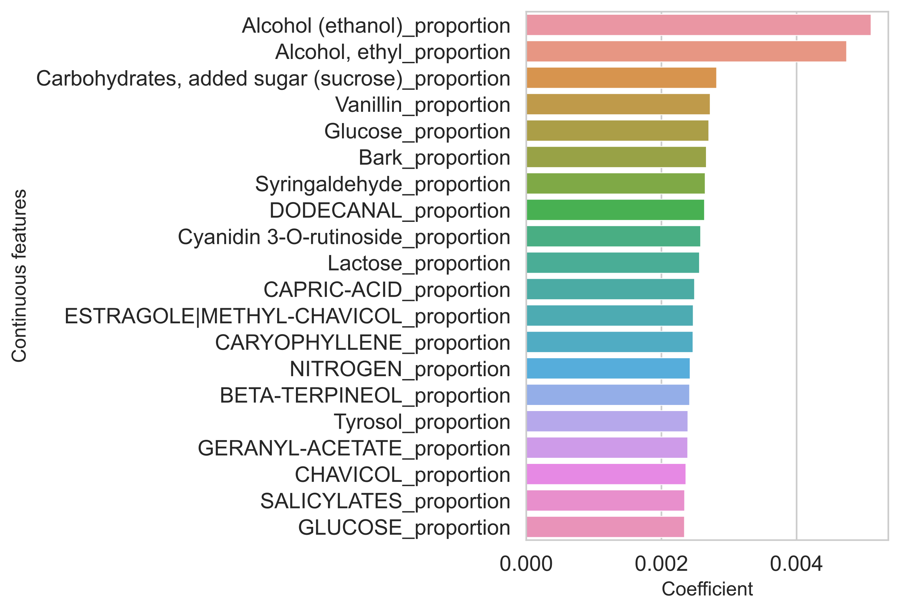
Logistic Regression (on continuous features) coefficients
contributors
(positive coefficients)

Slide 43
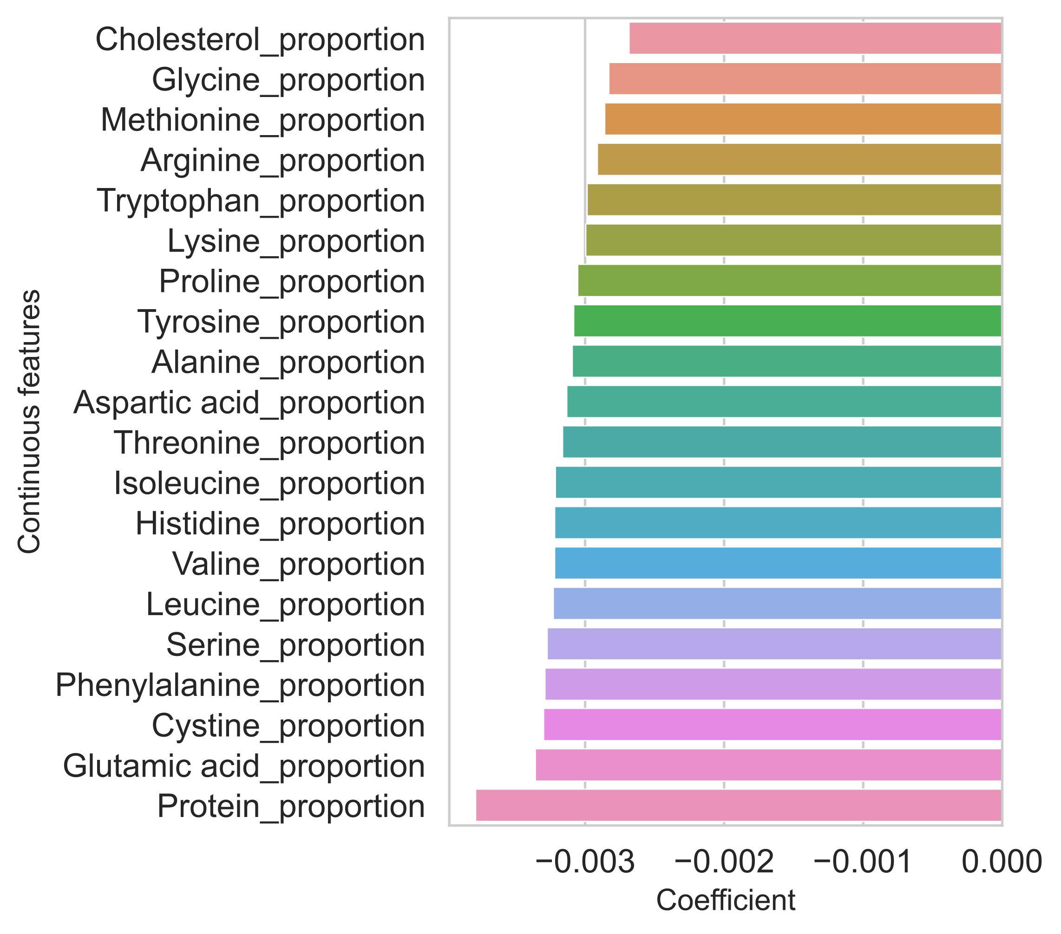
Logistic Regression (on continuous features) coefficients
detractors
(negative coefficients)

Slide 44
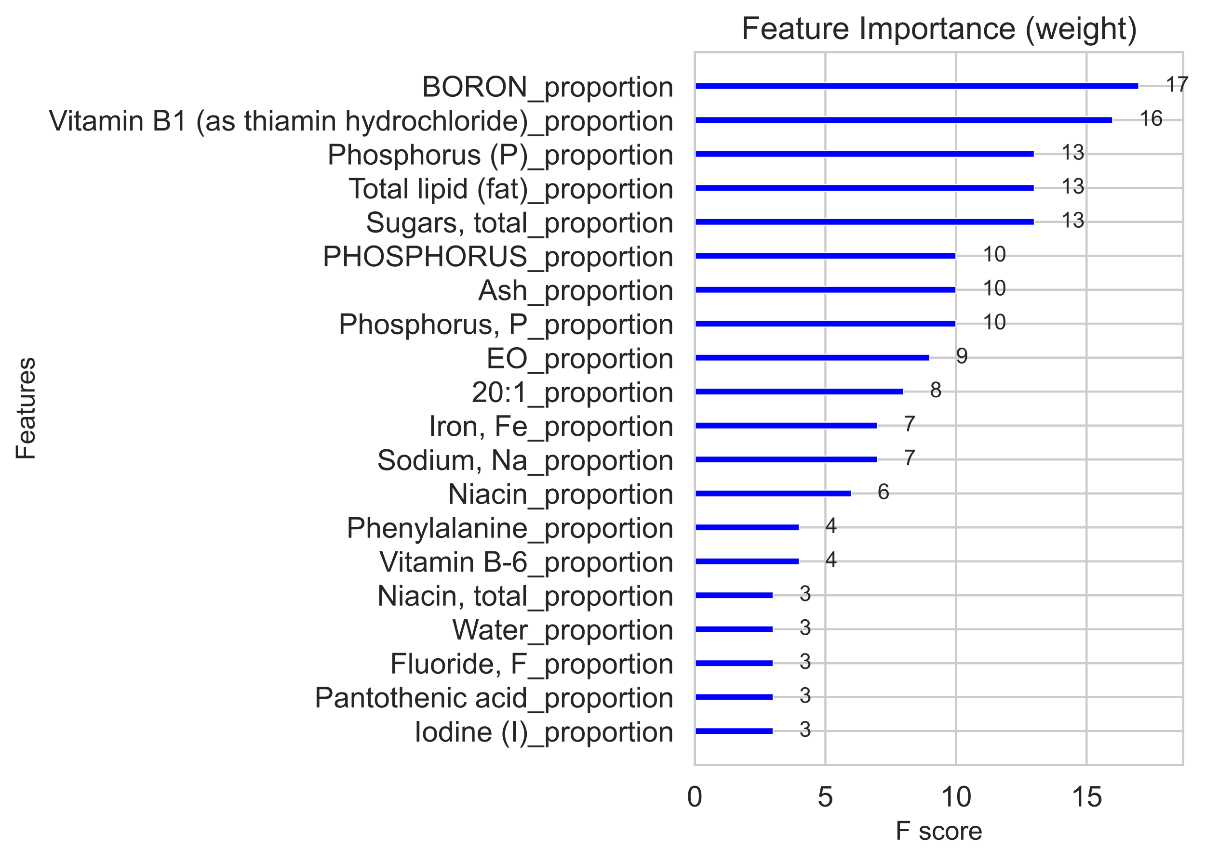
XGBoost ‘Important Features’
‘weight’

Slide 45
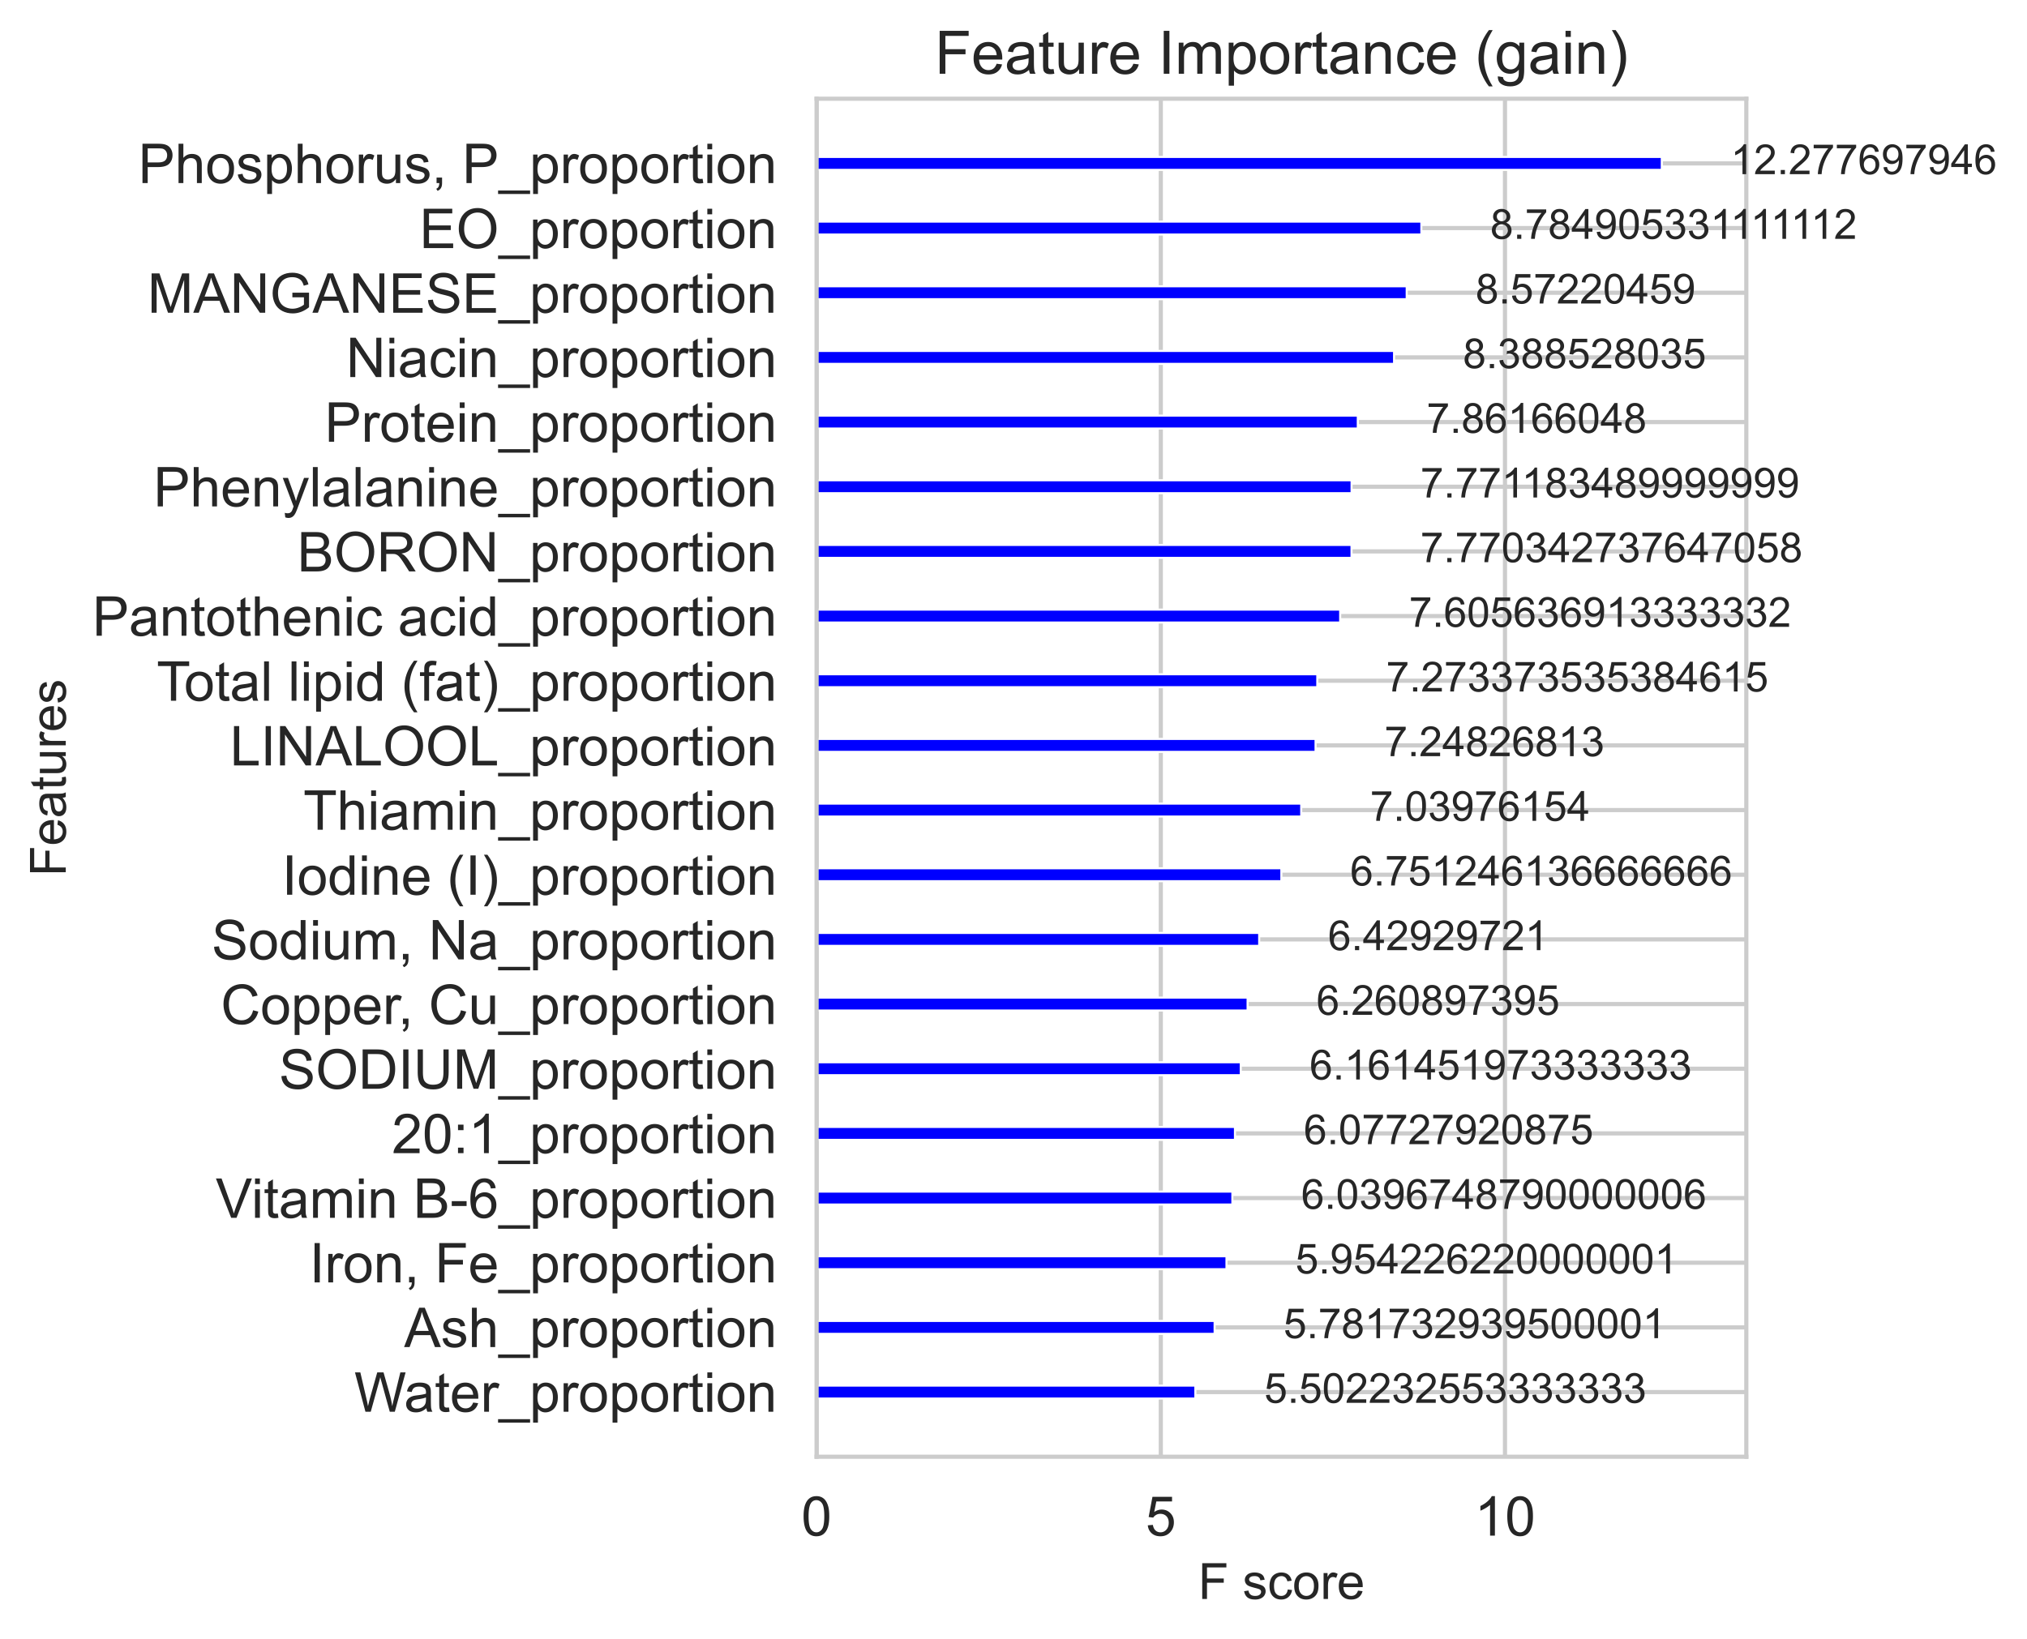
XGBoost ‘Important Features’
‘gain’

Slide 46
Exploring False Positives
to identify candidate ingredients for new cocktails

Slide 47
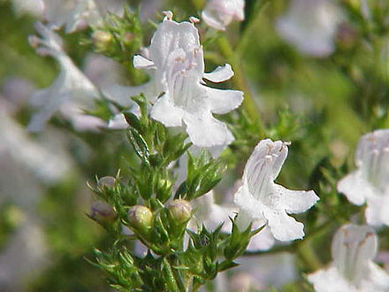
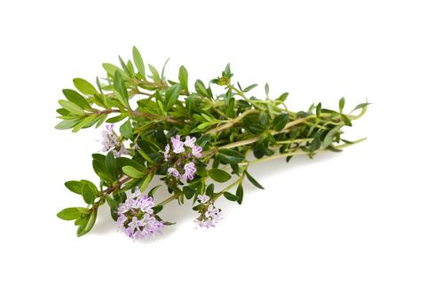
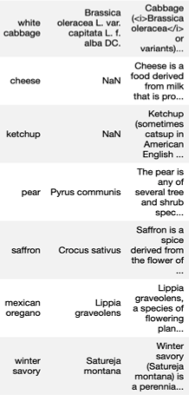
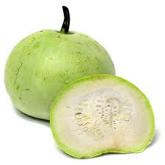
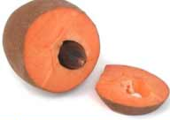

Intriguing false positives
Satureja montana (winter savory)
like thyme but stronger
Tinda, Indian squash, mild like a cucumber
Pouteria sapota, mamay, a Mexican and Central American tree fruit
ZiziphusJujube, Chinese date
capers
mustard ?
https://www.freepik.com/vectors/background graphic created by vectorpocket - www.freepik.com

Slide 48
Future steps
• Use preparation (cooked vs. raw) and odor category (woody, herbaceous, fatty, balsamic)
• Examine linear-combination coefficients of PCA features
• Consider feature interactions (polynomials)
• Interactive scatter plot with predict_proba against continuous PCA features, using tooltips to explore false positives
• Attempt to eliminate features from the models

Slide 49
Long-term future steps
• Incorporate data on food shape and texture
• Apply to other food-drink combinations, such to coffee or ice cream

Slide 50
To cocktail or not to
Joshua Banks Mailman

Slide 51
Appendix

Slide 52
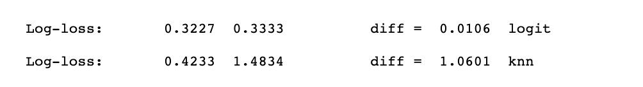
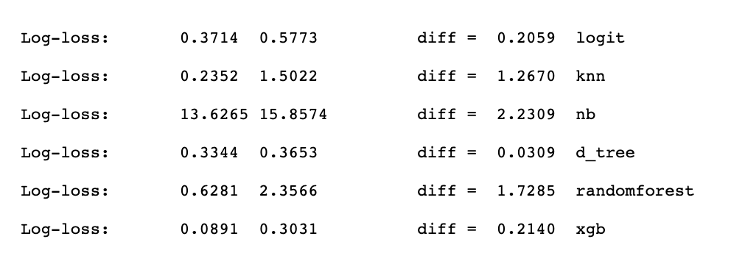
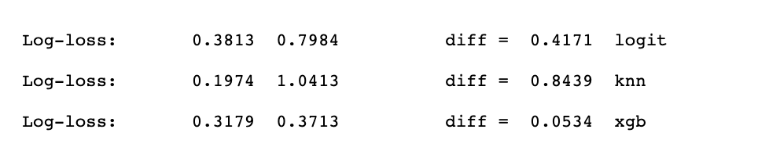
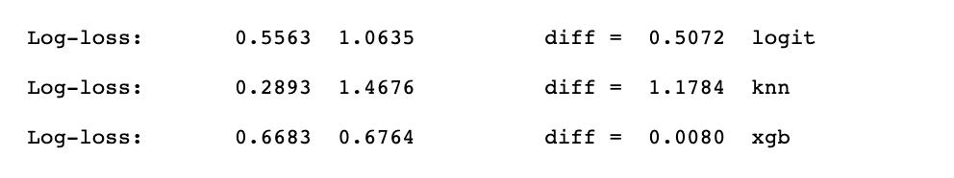
categorical only
categorical only
Logit
0.3340 0.3047 -0.0293
to gauge overfitting
train val difference
Non-speculative continuous features
speculative continuous features
to gauge overfitting
speculative continuous features pca
Non-speculative cat & pca oversampling
speculative continuous features pca oversampling

Slide 53
Appendix

Slide 54
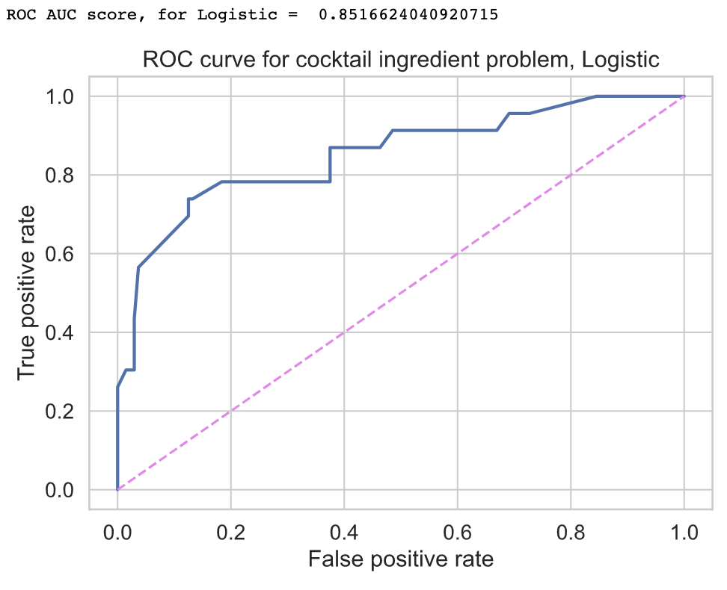
Two trials of Logistic Regression on categorical features
train val difference
0.3340 0.3047 -0.0293

Slide 55
Post-hoc analysis using Gridsearch, 5-fold Cross-validation and additional metrics: Avg. precision & Brier

Slide 56
0.3210 0.3382 0.0172
15,712 categorical & continuous features
1351 categorical & continuous features
100 Principal Components (PCA)
exclude empty columns
dimensionality reduction
Gridsearch 5-fold Cross-Validated analysis
Best performing
model score
Probabilistic metrics
Log-loss cross entropy KNN 0.07 (0 is best)
Brier Logistic 0.06 (0 is best)
Ranking metric
Avg. Precision (like PR AUC) Logistic 0.72 (1 is best)

Slide 57
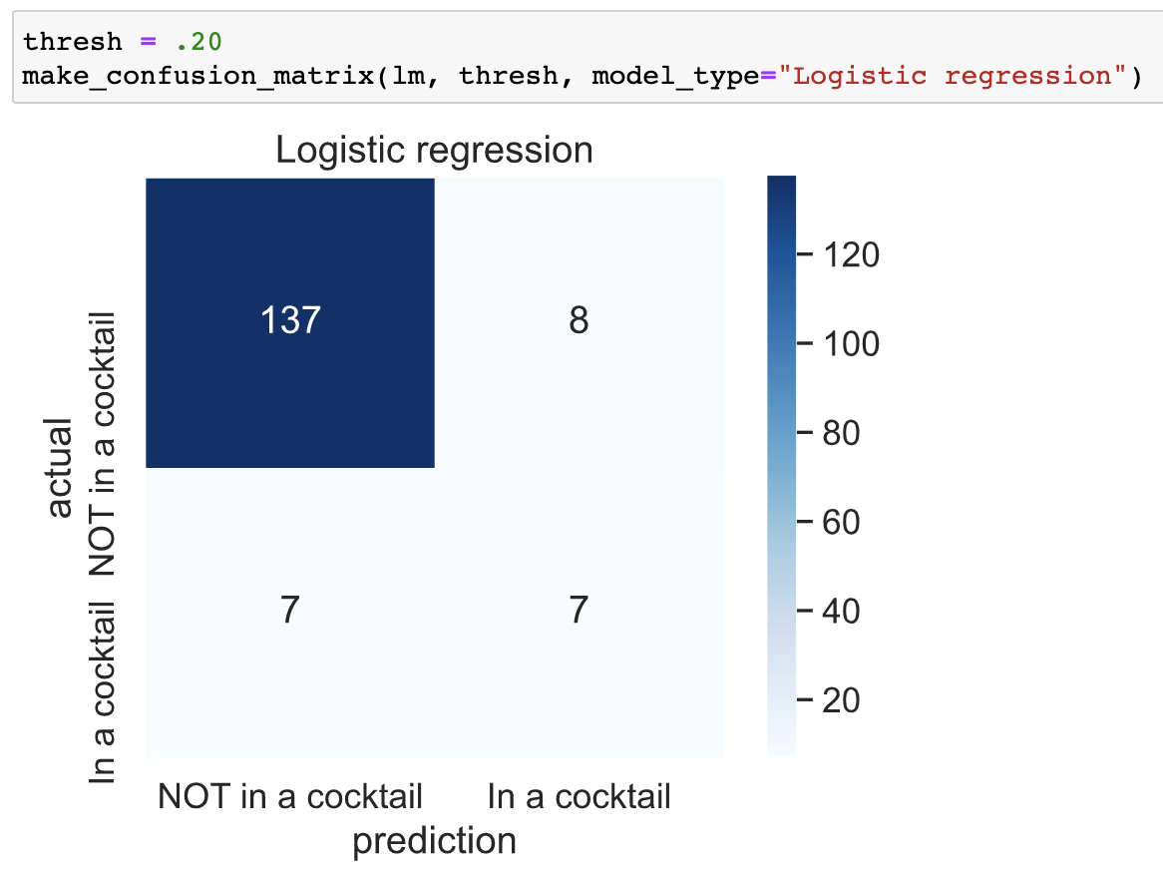
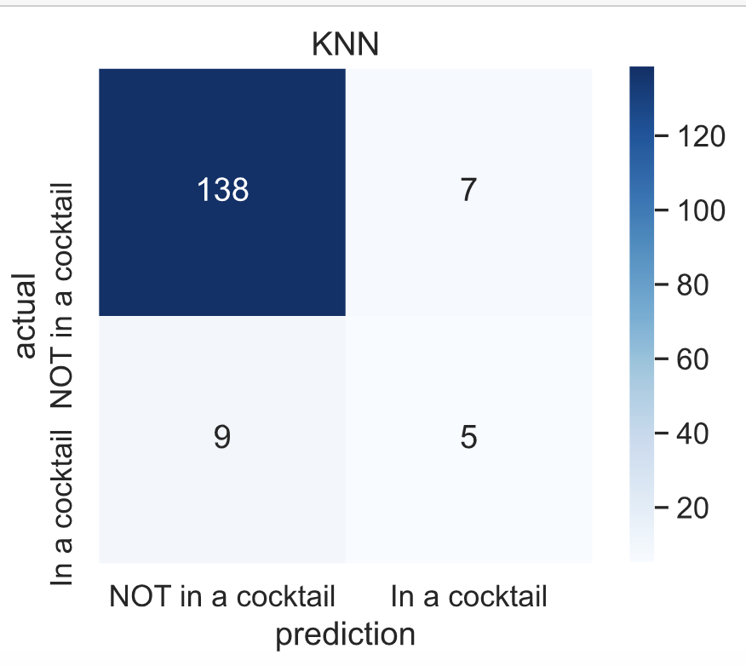

Slide 58
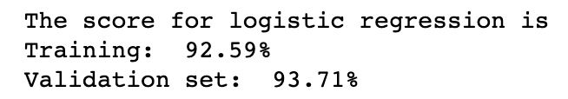
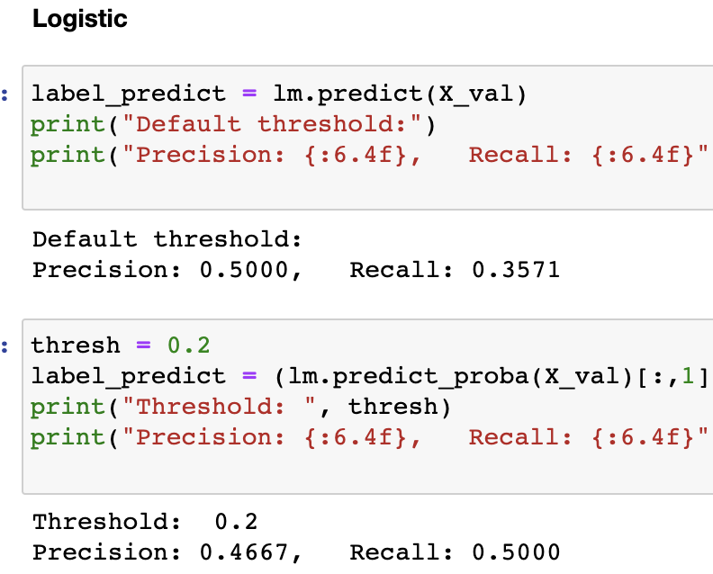
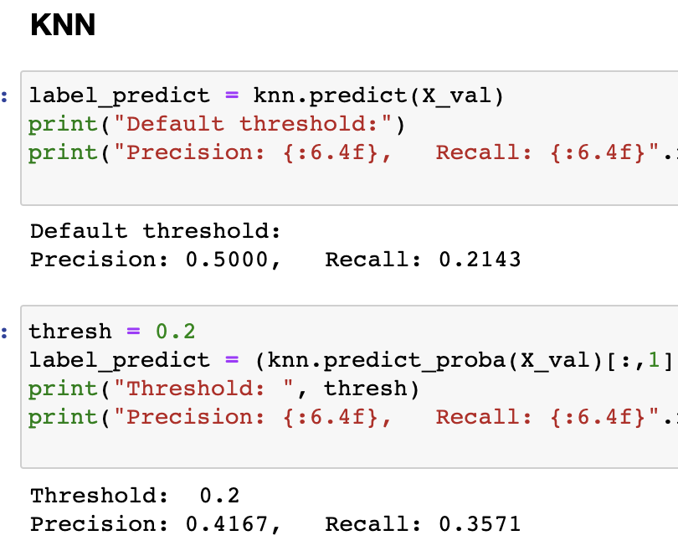

Slide 59
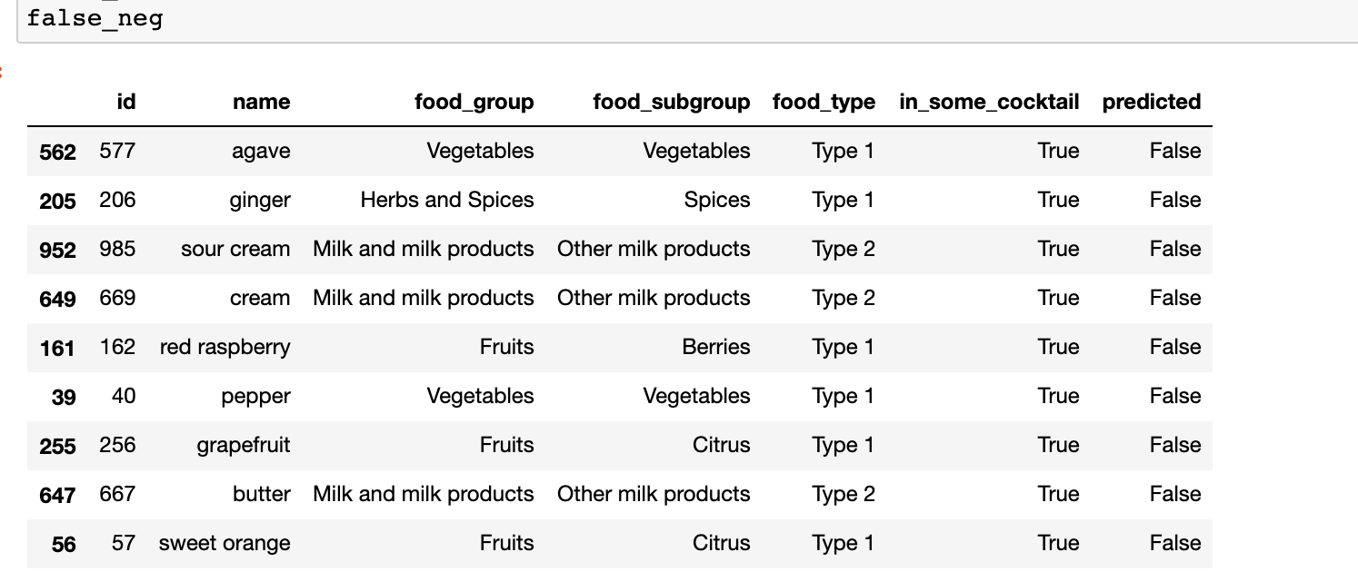

Slide 60
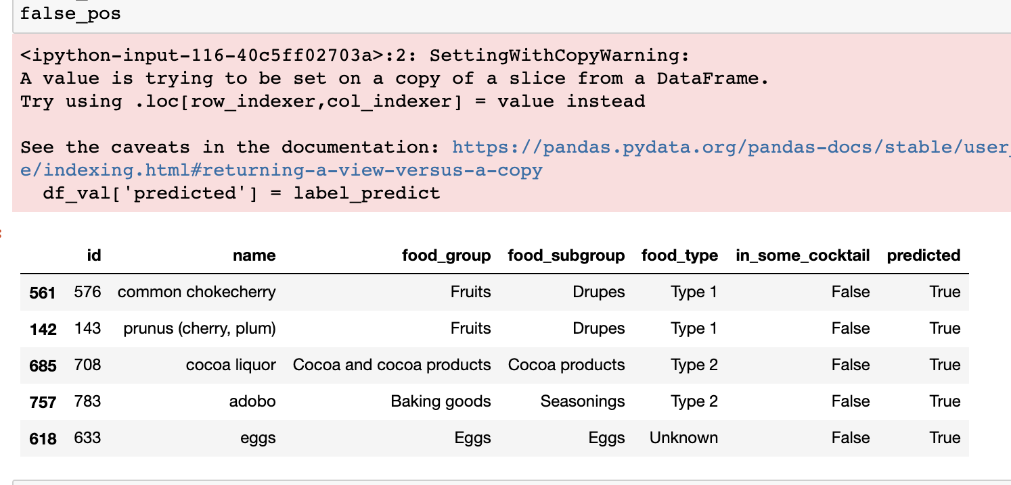

Slide 61



Slide 62



Slide 63



Slide 64



